Slide 1
Meeting of the Investment Advisory Council
September 20, 2021

Slide 2
Meeting of the Investment Advisory Council
Item 1. Welcome/Call to Order/Approval of Minutes
Peter Jones, Chair
(See Attachments 1A – 1B)
Action Required

Slide 3
Meeting of the Investment Advisory Council
Item 2. Opening Remarks/Reports/Other Updates & Reports
Ash Williams, Executive Director & CIO
Executive Staff
(See Attachments 2A – 2E)

Slide 4
Meeting of the Investment Advisory Council
Item 3. Asset Liability Review
Kristen Doyle
Katie Comstock
John Sullivan
Aon
(See Attachment 3A)

Slide 5
Pension Asset-Liability Study: Initial Results
Florida State Board of Administration
August 2021
Notes:
Imagery on cover and divider slides can be a L1A, L1B, L1C or L2 image
The image needs to be cropped within the current window specs
Try to use the same categories of images in your various divider slides (i.e. all L2)
A library of stock photography (L2 images) and data ribbons (L1C) have been pre-cropped to correct specs and are available for use. If you wish to use an L1A or L1B image, these will need to be created through a designer who has access to Adobe Creative Suite.

Slide 6
Table of Contents
  Executive Summary
  Analysis
    Asset-Liability Profile
    SBA Approach to Assumption Development
    Portfolio Analysis
    Asset-Liability Projection Analysis
    Liquidity Analysis
    Public Pension Peer Comparison
  Summary & Conclusions
  Appendix

Slide 7
Executive Summary

Slide 8






Challenges & Potential Solutions for Public Pension Plan Sponsors
Uncertainty Lies Ahead
Wide range of future outcomes; expect a rocky road rather than a smooth line
Challenged But Improving Financial Situation
Plan is underfunded as of June 30, 2021; sources of governmental revenues may be strained
Challenges
Potential
Solutions
Portfolio Construction
Evaluate Financial Impacts
How do different portfolios impact key financial measures such as funded ratio and contribution rates; sequence of future returns is important when the Plan is underfunded
Diversification addresses potential volatility; consider illiquid alternatives if Plan’s liquidity is manageable

Slide 9
Scope of Project
Annual Asset-Liability Management (ALM) review and update
    30 year asset-liability projection analysis
    Review stochastic risk/reward results
    Review multiple portfolio strategies
    Conduct liquidity analysis

Slide 10
Executive Summary
Investment
Analysis
  We believe the current portfolio is well-diversified with 81% return-seeking assets
  The equity risk premium is 3.92% in this 2021 Asset-Liability Study, compared to 5.15% from 2020; the change is driven by the combination of lower projected equity returns and higher fixed income returns year-over-year
  Asset returns (6.13%) are not expected to keep pace with the actuarial assumed rate of return (7.00%)
Asset-Liability
Projection
Analysis
  Longer time horizons are expected to reward higher levels of risk; shorter time horizons are not
  The funded ratio is expected to improve with FYE 2021 returns and then remain relatively flat over the course of the projection period in our central expectation (50th percentile outcome)
  Adverse market experience could significantly impact the funded status of the Plan over the projection period, albeit with low likelihood
Liquidity
Analysis
  The current portfolio is projected to have sufficient liquidity in the modeled Base, Recession, and Dark Skies scenarios

Slide 11
Analysis
Asset-Liability Profile

Slide 12
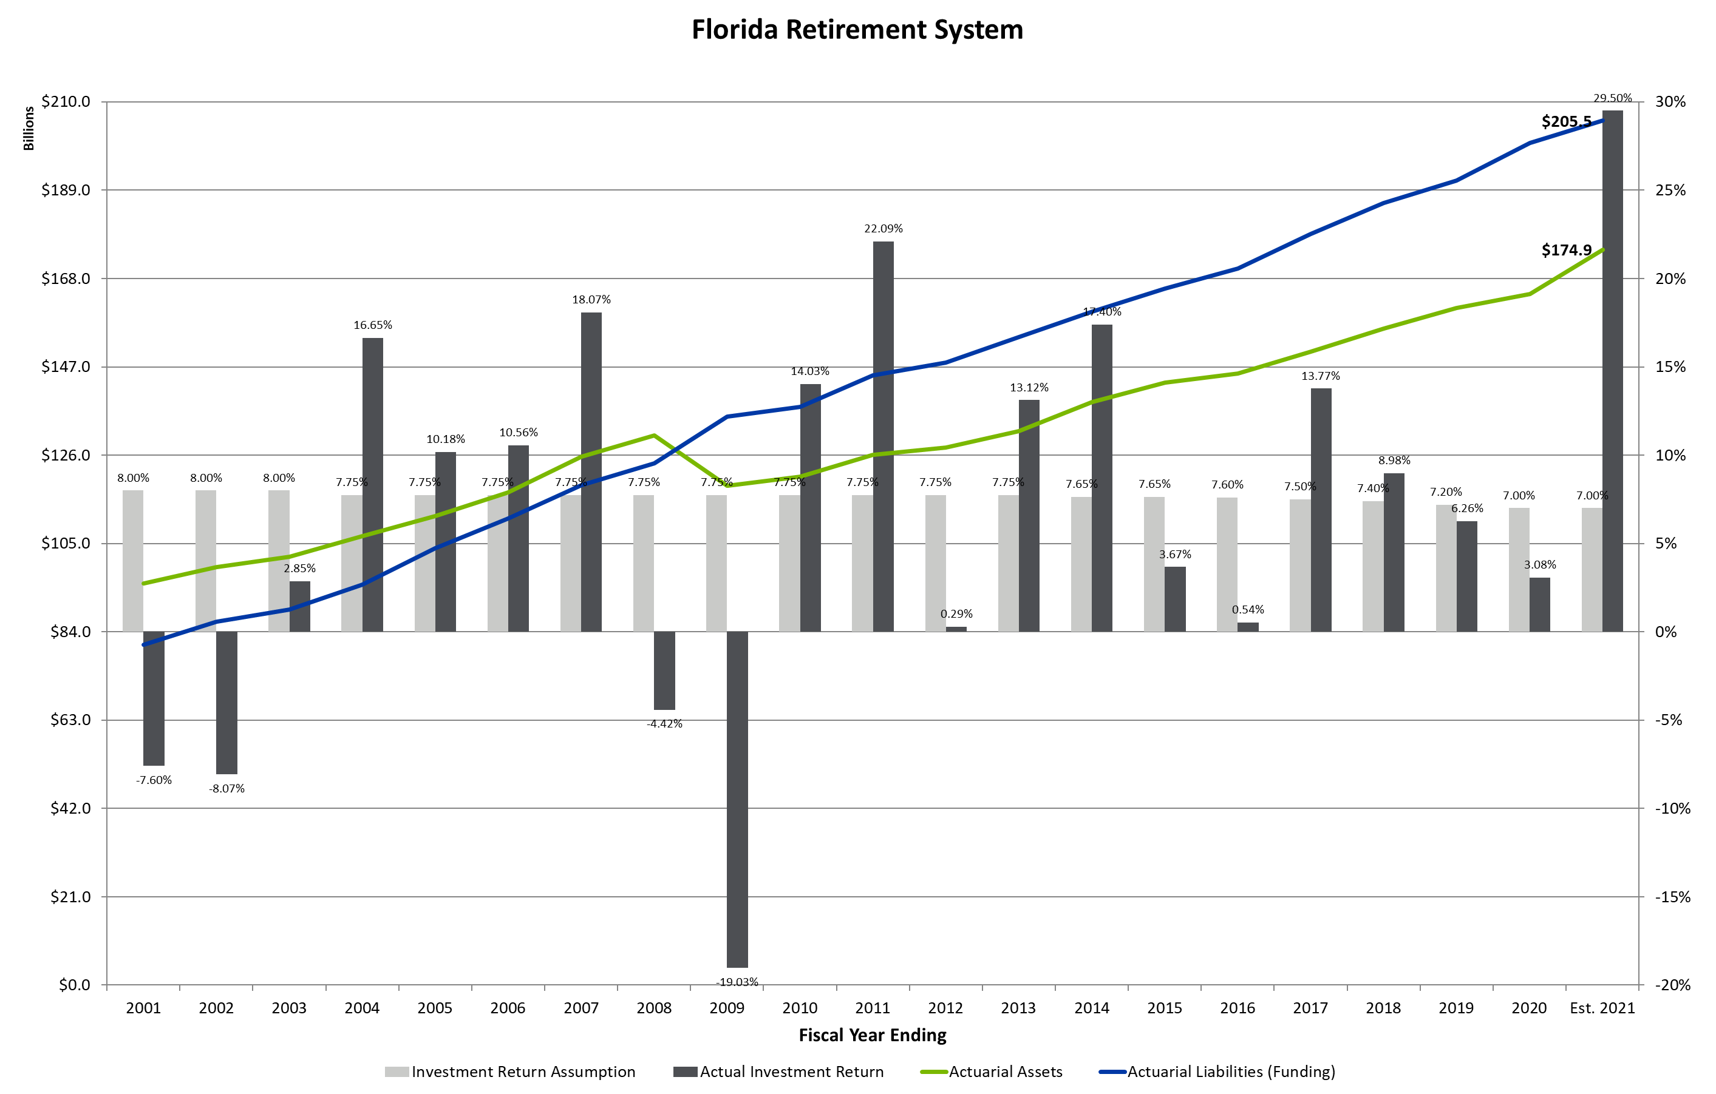
Florida Retirement System (FRS)
Historical Information
Key Takeaways:
  Blue line represents the actuarial liabilities over time
    Adding to the increase in liability has been the decrease in the assumed investment return in recent years (light gray bar)
  Green line represents the actuarial value of plan assets over time
    Assets reflect smoothing parameters to the actual return on assets (dark gray bar)
Sources: Public Plans Data (publicplansdata.org) as of August 2021

Slide 13
Current State Asset-Liability Profile
Asset-Liability Snapshot
Metric ($, Billions) | As of 7/1/2020 |  |  | As of 7/1/2021
 | Value | Fund % |  | Value | Fund %
Market Value of Assets | $161.6 | 80.7% |  | $199.6 | 97.1%
Actuarial Value of Assets | $164.3 | 82.0% |  | $174.9 | 85.1%
Liability Metrics
Actuarial Liability (AL) - Funding | $200.3 |  |  | $205.5
Key Takeaways:
  Pension plan is estimated to be 97.1% funded on a market value of assets basis as of July 1, 2021
  Asset allocation is 81% return-seeking assets with 19% risk-reducing/safety assets to withstand stressed markets
  Asset hurdle rate of 8.57%, via cash funding and investment returns, needed to maintain or improve actuarial funded status
Asset-Liability Growth Metrics
Metric ($, Billions) | Value | % Liability | % Assets
AL Discount Cost | $14.4 | 7.00% | 7.21%
AL Normal Cost | $2.7 | 1.32% | 1.36%
Total Liability Hurdle Rate | $17.1 | 8.32% | 8.57%
Expected Return on Assets² | $12.2 | 5.95% | 6.13%
Total Contributions | $5.0 | 2.42% | 2.49%
Total Exp. Asset Growth | $17.2 | 8.37% | 8.62%
Hurdle Rate Shortfall/(Surplus) | -$0.1 | -0.05% | -0.05%
Est. Benefit Payments | $11.2 | 5.47% | 5.63%
Target Asset Allocation as of 6/30/2021
Metric ($, Billions) |  | Value | Alloc %
Return-Seeking
- Global Equity |  | $105.8 | 53%
- Private Equity |  | $12.0 | 6%
- Real Estate |  | $20.0 | 10%
- Strategic Allocation |  | $24.0 | 12%
- Total |  | $161.7 | 81%
Risk-Reducing
- Cash & Short Duration Fixed Income |  | $2.0 | 1%
- Intermediate Duration Fixed Income |  | $35.9 | 18%
- Total |  | $37.9 | 19%
Total |  | $199.6 | 100%
¹ | Based on a 7.00% discount rate consistent with the July 1, 2020 valuation results.
² | Expected returns are using customized Aon Investments’ Q3 2021 Capital Market Assumptions. Assumptions do not include fees/expenses. All expected returns are geometric (long-term compounded; rounded to the nearest decimal) and net of investment fees. Expected returns presented are models and do not represent the returns of an actual client account. Not a guarantee of future results. See capital market assumptions disclosure pages in Appendix.

Slide 14
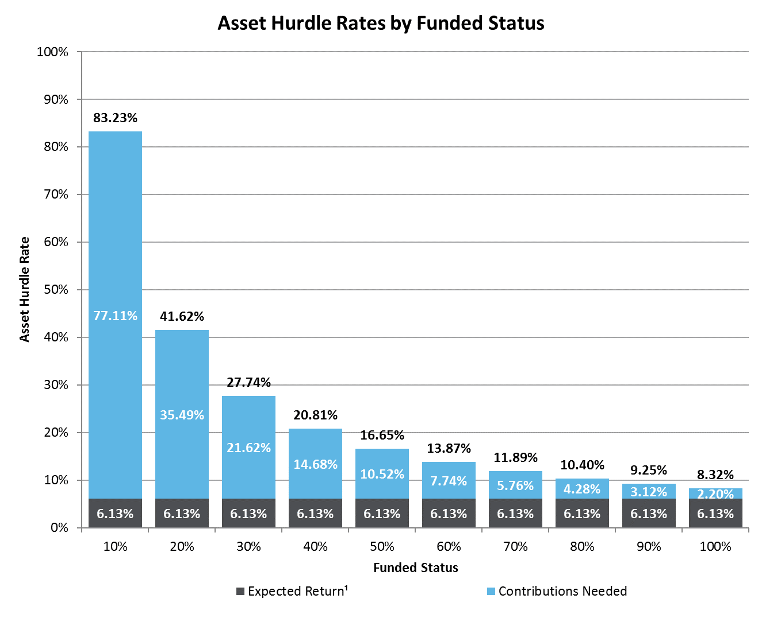
Asset Hurdle Rates
Asset Hurdle Rate is the required rate of asset growth needed to keep pace with the growth of the Plan liabilities
  Assets must grow at this rate or more in order to maintain or reduce the existing funding shortfall
Assets can grow via:
  Investment performance, and/or
  Funding contributions
Asset hurdle rates decline as the funded status increases, as shown in the chart to the right
FRS’ 7/1/2021
Hurdle Rate = 8.57%
¹ | Expected returns are using customized Aon Investments’ Q3 2021 Capital Market Assumptions. Assumptions do not include fees/expenses. All expected returns are geometric (long-term compounded; rounded to the nearest decimal) and net of investment fees. Expected returns presented are models and do not represent the returns of an actual client account. Not a guarantee of future results. See capital market assumptions disclosure pages in Appendix.

Slide 15
Analysis
SBA Approach to Assumption Development

Slide 16
SBA Approach to Assumption Development
Overview
The SBA approach averages the global equity risk premiums¹ from three investment advisors (Aon Investments, Mercer, and Wilshire)
  Callan was previously included in the averaging but removed starting in 2019 because its capital market assumption date did not coincide with the same timeframe as the other consultants and the asset-liability study; Callan only updates their capital market assumptions once a year while the other consultants update quarterly
Building block approach is used
  Price inflation and fixed income returns reflect market conditions and yields
  For all other asset classes (“risk assets”), a risk premium is added to fixed income returns
Average risk premium is used to scale Aon Investments’ expected returns for the “risk assets”
¹ Equity Risk Premium is defined as the excess return earned over bonds that compensates investors for taking on higher risk; all returns are 15-year geometric average (compounded) expected returns

Slide 17
SBA Approach to Assumption Development
Equity Risk Premium¹
The SBA averages the global equity risk premiums from three consulting firms² and then uses that average risk premium to scale Aon Investments’ expected returns for the “risk assets”
2021 Average Global Equity Risk Premium = Average (Global Equity Return – U.S. Bond Return) = 3.92%
 | Aon Investments | Mercer | Wilshire | Callan² | Average
2021 Assumptions (15-year geometric average expected returns)
- As of Date | June 2021 | July 2021 | June 2021
- Global Equity | 6.75% | 5.80% | 5.40% | N/A | 5.98%
- Core U.S. Bonds | 2.20% | 2.13% | 1.85% | N/A | 2.06%
- Global Equity Risk Premium | 4.55% | 3.67% | 3.55% | N/A | 3.92%
2020 Global Equity Risk Premium | 5.50% | 4.77% | 5.20% | N/A | 5.15%
Change 2021 vs. 2020 | -0.95% | -1.10% | -1.65% | N/A | -1.23%
Prior Years:
- 2019 | 4.55% | 3.70% | 3.40% | N/A | 3.88%
- 2018 | 4.10% | 3.53% | 2.90% | 3.93% | 3.62%
- 2017 | 3.75% | 4.13% | 3.05% | 3.93% | 3.72%
¹ Equity Risk Premium is defined as the excess return earned over bonds that compensates investors for taking on higher risk.
² Callan was previously included in the averaging but removed starting in 2019 because its capital market assumption date did not coincide with the same timeframe as the other consultants and the asset-liability study; Callan only updates their capital market assumptions once a year while the other consultants update quarterly
Calculations may not sum to total due to rounding

Slide 18
SBA Approach to Assumption Development
Breakdown of Equity Risk Premium (ERP) Assumption¹
The decrease in the 2021 equity risk premium was driven by the combination of lower projected equity returns and higher fixed income returns
  Below is a 6-year historical look at the breakdown of the global equity risk premium
¹ Equity Risk Premium is defined as the excess return earned over bonds that compensates investors for taking on higher risk; all returns are 15-year geometric average (compounded) expected returns

Slide 19
SBA Approach to Assumption Development
Historical Equity Risk Premium (ERP) Assumption¹
Average Global Equity Risk Premium = Average (Global Equity Return – U.S. Bond Return)
Equity Risk Premium² | Asset-Liability Study/Update³
 | 2011 | 2012 | 2013 | 2015 | 2016 | 2017 | 2018 | 2019 | 2020 | 2021
Aon | 3.60% | 4.50% | 5.10% | 3.62% | 3.70% | 3.75% | 4.10% | 4.55% | 5.50% | 4.55%
Callan | 4.25% | 4.50% | 5.15% | 4.60% | 4.45% | 3.93% | 3.93% | N/A | N/A | N/A
Mercer | 3.80% | 3.80% | 4.30% | 3.00% | 4.40% | 4.13% | 3.53% | 3.70% | 4.77% | 3.67%
Wilshire | 3.50% | 4.65% | 4.50% | 2.90% | 3.20% | 3.05% | 2.90% | 3.40% | 5.20% | 3.55%
Average | 3.79% | 4.36% | 4.76% | 3.53% | 3.94% | 3.72% | 3.62% | 3.88% | 5.15% | 3.92%
Aon Investments’ capital market assumptions for risk assets will be scaled by -63bps
¹ Equity Risk Premium is defined as the excess return earned over bonds that compensates investors for taking on higher risk; all returns are 15-year geometric average (compounded) expected returns
² Global equity risk premium used starting in 2016; prior years were based on U.S. equity risk premiums
³ An asset-liability study was not completed in 2014

Slide 20
Analysis
Portfolio Analysis

Slide 21
Spectrum of Aon Model Portfolios
Aon’s Model Portfolios reflect Aon’s best ideas for a typical total return defined benefit plan across a range of circumstances noted below
  Intended as a starting point for asset allocation analysis and decision-making and to be customized based on client-specific needs and circumstances
As a general statement, moving from left-to-right on the above spectrum increases both investment portfolio return potential and risk-adjusted return potential, based on our capital markets modelling.
 | Efficiency | Model 1 | Model 2 | Model 3 (Opportunity)
Complexity | Simple |  |  | Complex
Costs | Low Cost |  |  | Higher Cost
Resources | Light Resources |  | Deep Resources
Governance | Modest Governance |  | Strong Governance
Liquidity | More Liquid |  |  | Less Liquid

Slide 22
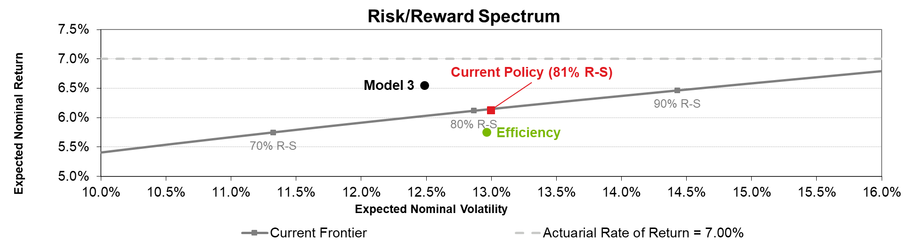
Portfolio Analysis
Current Frontier
Key Takeaways:
The current portfolio is well-diversified
  Return-seeking assets are broadly diversified
  Safety asset allocation should withstand stressed markets
  Additional diversification via illiquid assets is expected to improve the risk/return profile, although statutory limits preclude Aon’s Model 3 portfolio
Ideal
 |  |  |  |  |  | Return-Seeking Assets |  |  |  |  |  |  |  |  | Risk-Reducing / Safety Assets
 | Expected Nominal Return¹ | Expected Nominal Volatility | Sharpe Ratio |  |  | Public Equity | Private Equity | Strategic Allocation² | Multi Asset Credit | Private Debt | Real Estate³ | Infra- structure |  |  | Cash | Core/ Core Plus Bonds | Interm. Duration Gov’t Bonds | Interm. Duration Credit
Current Policy (81% R-S) | 6.13% | 12.99% | 0.325 |  |  | 53% | 6% | 12% | 0% | 0% | 10% | 0% |  |  | 1% | 0% | 9% | 9%
Efficiency | 5.75% | 12.96% | 0.297 |  |  | 61% | 0% | 0% | 8% | 0% | 12% | 0% |  |  | 1% | 18% | 0% | 0%
Model 3 | 6.55% | 12.49% | 0.373 |  |  | 35% | 15% | 10% | 0% | 5% | 10% | 5% |  |  | 1% | 18% | 0% | 0%
Current Frontier
60% Return-Seeking | 5.36% | 9.82% | 0.352 |  |  | 39% | 4% | 9% | 0% | 0% | 7% | 0% |  |  | 1% | 39% | 0% | 0%
70% Return-Seeking | 5.75% | 11.33% | 0.340 |  |  | 46% | 5% | 10% | 0% | 0% | 9% | 0% |  |  | 1% | 29% | 0% | 0%
80% Return-Seeking | 6.12% | 12.87% | 0.328 |  |  | 52% | 6% | 12% | 0% | 0% | 10% | 0% |  |  | 1% | 19% | 0% | 0%
90% Return-Seeking | 6.47% | 14.43% | 0.316 |  |  | 59% | 7% | 13% | 0% | 0% | 11% | 0% |  |  | 1% | 9% | 0% | 0%
100% Return-Seeking | 6.80% | 16.01% | 0.306 |  |  | 65% | 7% | 15% | 0% | 0% | 12% | 0% |  |  | 0% | 0% | 0% | 0%
¹ Expected return assumptions are based upon the Aon Investments capital market assumptions adjusted for the delta in Global Equity Risk Premium (ERP) among three investment advisors: Mercer, Wilshire, and Aon Investments (-63bps adjustment)
² Strategic assumption breakdown is found in the Appendix
³ Current Real Estate assumption was modeled as 76.5% Core Real Estate / 13.5% Non-Core Real Estate / 10.0% REITs
Percentages in table may not sum to 100% due to rounding

Slide 23
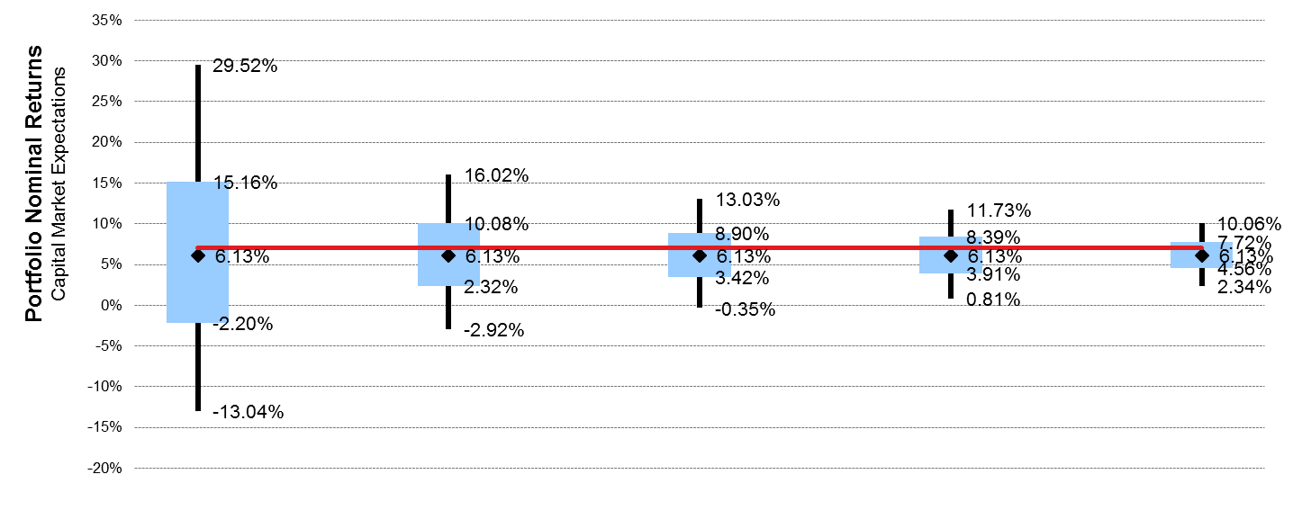
Portfolio Analysis
Range of Nominal Returns
Actuarial assumed rate of return (7.00%)
Percentile | Current Policy – 1 Year | Current Policy – 5 Year | Current Policy – 10 Year | Current Policy – 15 Year | Current Policy – 30 Year
5th | -13.04% | -2.92% | -0.35% | 0.81% | 2.34%
25th | -2.20% | 2.32% | 3.42% | 3.91% | 4.56%
50th | 6.13% | 6.13% | 6.13% | 6.13% | 6.13%
75th | 15.16% | 10.08% | 8.90% | 8.39% | 7.72%
95th | 29.52% | 16.02% | 13.03% | 11.73% | 10.06%
Note: Returns based on Aon Investments' 30 Year Capital Market Assumptions as of June 30, 2021 adjusted for the average global equity risk premium

Slide 24
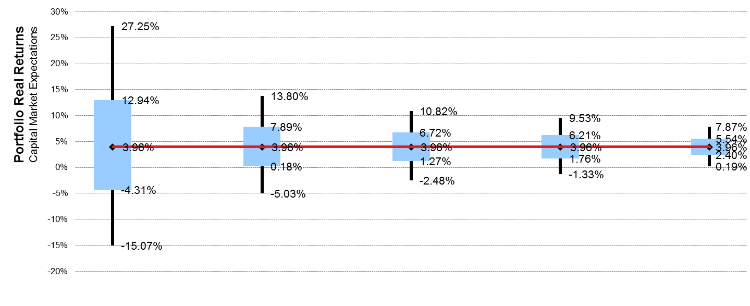
Portfolio Analysis
Range of Real Returns
Absolute Real Target Rate of Return (4.00%)
Percentile | Current Policy – 1 Year | Current Policy – 5 Year | Current Policy – 10 Year | Current Policy – 15 Year | Current Policy – 30 Year
5th | -15.07% | -5.03% | -2.48% | -1.33% | 0.19%
25th | -4.31% | 0.18% | 1.27% | 1.76% | 2.40%
50th | 3.96% | 3.96% | 3.96% | 3.96% | 3.96%
75th | 12.94% | 7.89% | 6.72% | 6.21% | 5.54%
95th | 27.25% | 13.80% | 10.82% | 9.53% | 7.87%
Note: Returns based on Aon Investments' 30 Year Capital Market Assumptions as of June 30, 2021 adjusted for the average global equity risk premium

Slide 25
Analysis
Asset-Liability Projection Analysis

Slide 26
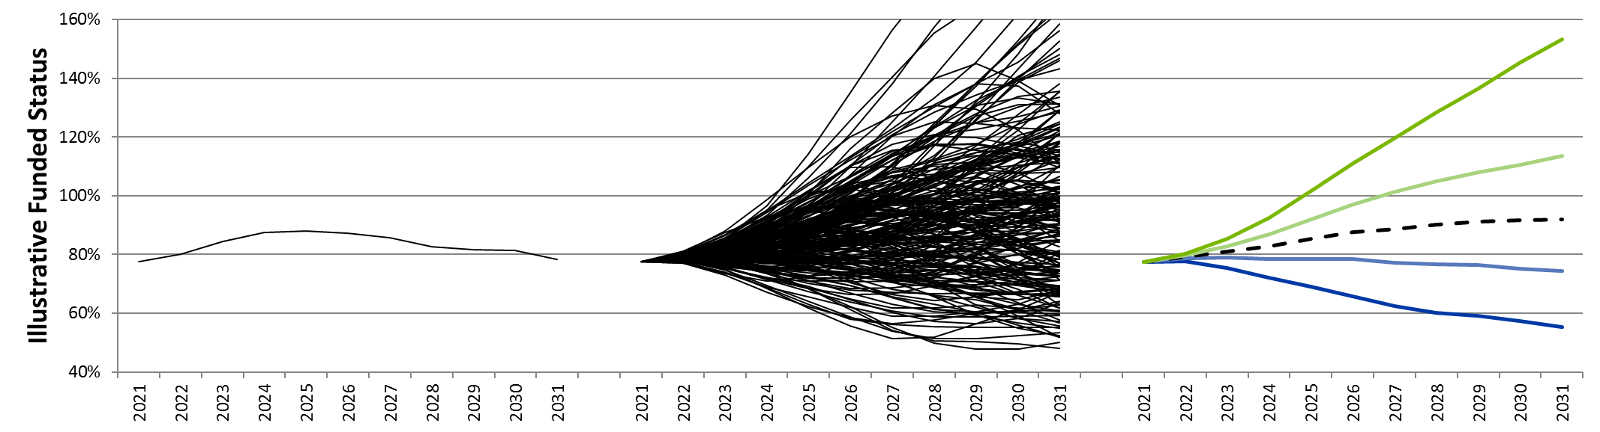
Asset-Liability Simulation Overview
  Thousands of simulations plotted in one graph would be impossible to interpret
  Instead, we rank the simulations at each point over the future
  This produces a distribution of outcomes illustrating the degree of uncertainty of a plan’s financial position over the projection period
  Different investment strategies will produce different distributions of outcomes
Single Simulation
Many Simulations
Distribution of Outcomes
  * The path of a given scenario will follow a much less smooth pattern than the distribution suggests, as illustrated above

Slide 27
Asset-Liability Projection Analysis
Market Value of Assets / Actuarial Liability Funded Ratio
Key Takeaways:
Under the Current Policy (81% R-S), the funded ratio is expected to increase with FYE 2021 performance, then decline in the near-term before increasing later at the end of the period in the central expectation (50th percentile outcome)
Higher return-seeking allocations will increase the central trendline of funded ratio, albeit with greater downside risk
Downside risk (5th percentile outcomes) illustrates a small likelihood of significant funded ratio deterioration over the projection period
* Projections assume constant 7.00% discount rate for pension liabilities for all investment policies studied

Slide 28
Asset-Liability Projection Analysis
Employer Contribution Rate (“Blended Rate”)
Key Takeaways:
Employer contribution rate is expected to decrease with recent asset performance before increasing back to 12% over the next two decades
Higher return-seeking allocations will reduce the expected (50th percentile) outcome but with a wider range of outcomes
95th percentile results show potential contribution rates in excess of 30% over the next two decades, albeit with low likelihoods
* Projections assume constant 7.00% discount rate for pension liabilities for all investment policies studied
Note: Payroll is estimated to be $26.8B for Normal Cost purposes and $37.9B for UAL purposes as of 7/1/2020

Slide 29
Asset-Liability Projection Analysis
Total Contributions Amounts (Employer + Employee)
Key Takeaways:
Total contribution amounts are expected to decline initially before increasing over the next two decades and finally decrease once amortization bases are fully recognized
Higher return-seeking allocations will reduce the expected (50th percentile) outcome but with a wider range of outcomes
* Projections assume constant 7.00% discount rate for pension liabilities for all investment policies studied

Slide 30
Asset-Liability Projection Analysis
Net Outflow Analysis: (Benefit Payments less Contributions) / Market Value of Assets
Key Takeaways:
Net outflows are expected to remain in the 3-5% range over the projection period
Net outflows of 10%+ can put stress on fund liquidity over time; however, it is not likely over the projection period
* Projections assume constant 7.00% discount rate for pension liabilities for all investment policies studied

Slide 31
Asset-Liability Projection Analysis
Economic Cost Analysis over a 2, 5, 10, and 15-Year Horizon
Key Takeaways:
Short time horizons (2 years) show largely horizontal economic cost curves – i.e., added risk does not result in a significant expected reward/economic cost reduction
Longer time horizons (15 years) show largely vertical economic cost curves – i.e., added risk does result in a significant expected reward/economic cost reduction
Ideal
* Projections assume constant 7.00% discount rate for pension liabilities for all investment policies studied
Note: Excludes 50% of surplus in excess of 120% of Actuarial liability, and includes twice the shortfall below 40% of Actuarial liability, on a market value basis

Slide 32
Risk-Reward Analysis
Sensitivity to Equity Risk Premium Assumption
Observation:
The dashed lines illustrate how the Economic Cost curve shifts under alternative equity risk premium assumptions over a 5 and 15-year time horizon.
Ideal
* Projections assume constant 7.00% discount rate for pension liabilities for all investment policies studied
Note: Excludes 50% of surplus in excess of 120% of Actuarial liability, and includes twice the shortfall below 40% of Actuarial liability, on a market value basis

Slide 33
Asset-Liability Projection Results
Funded Ratio Analysis (Based on Market Value of Assets)
The Florida Retirement System is projected to have the following probability of exceeding key funded ratio thresholds under the Current portfolio mix:
Key Takeaways:
Higher risk portfolios are projected to have more upside potential over longer periods of time
Lower risk portfolios are expected to have higher downside protection in the near-term
 | After 5 Years |  |  |  |  |  | After 10 Years |  |  |  |  |  | After 30 Years
Funded Status | 60% R-S | 70% R-S | Current Policy (81% R-S) | 90% R-S | 100% R-S |  | 60% R-S | 70% R-S | Current Policy (81% R-S) | 90% R-S | 100% R-S |  | 60% R-S | 70% R-S | Current Policy (81% R-S) | 90% R-S | 100% R-S
100% | 30.4% | 36.2% | 41.0% | 44.1% | 46.9% |  | 27.5% | 34.1% | 39.5% | 43.3% | 46.8% |  | 35.1% | 43.3% | 50.8% | 56.0% | 60.5%
90% | 50.0% | 53.5% | 56.3% | 57.8% | 59.1% |  | 39.3% | 45.2% | 49.5% | 52.5% | 54.9% |  | 40.4% | 48.9% | 55.7% | 60.7% | 64.3%
80% | 71.9% | 72.0% | 72.0% | 71.9% | 71.6% |  | 54.1% | 57.6% | 60.2% | 61.7% | 63.2% |  | 47.4% | 54.8% | 61.4% | 65.7% | 68.9%
70% | 87.6% | 86.0% | 84.5% | 83.4% | 82.4% |  | 69.1% | 70.2% | 71.0% | 71.6% | 71.8% |  | 55.6% | 62.4% | 68.5% | 72.0% | 74.9%
60% | 95.9% | 94.4% | 92.7% | 91.5% | 90.2% |  | 83.1% | 82.6% | 81.6% | 81.2% | 80.4% |  | 66.1% | 71.8% | 76.2% | 78.8% | 80.9%
50% | 99.4% | 98.4% | 97.6% | 96.6% | 95.5% |  | 93.2% | 92.2% | 91.0% | 89.9% | 88.8% |  | 78.6% | 82.1% | 84.5% | 86.0% | 87.2%
40% | 99.9% | 99.8% | 99.6% | 99.2% | 98.5% |  | 98.3% | 97.5% | 96.2% | 95.1% | 94.2% |  | 90.0% | 91.5% | 92.1% | 92.8% | 93.0%
30% | 100.0% | 100.0% | 100.0% | 99.9% | 99.8% |  | 99.9% | 99.7% | 99.3% | 98.7% | 98.1% |  | 97.6% | 97.6% | 97.5% | 97.4% | 97.1%
20% | 100.0% | 100.0% | 100.0% | 100.0% | 100.0% |  | 100.0% | 100.0% | 100.0% | 99.9% | 99.8% |  | 100.0% | 99.9% | 99.7% | 99.7% | 99.4%
10% | 100.0% | 100.0% | 100.0% | 100.0% | 100.0% |  | 100.0% | 100.0% | 100.0% | 100.0% | 100.0% |  | 100.0% | 100.0% | 100.0% | 100.0% | 100.0%
Blue = Greater than 50% chance of surpassing a given threshold

Slide 34
Analysis
Liquidity Analysis

Slide 35
Liquidity Analysis | Background
FRS’ liquidity analysis is performed under its Current Policy (81% R-S) portfolio
  Intended as a stress-testing model, incorporating the profile of the liabilities as well as expected future contributions
  Uses different scenarios for economic environments and other relevant events
  Shows how the portfolio’s liquidity profile could evolve with a given investment strategy
We categorized investments by liquidity into five buckets
  Liquid (Risk-Reducing Assets): less than 3 months needed for return of capital (e.g. publicly traded securities)
  Liquid (Return-Seeking Assets): less than 3 months needed for return of capital (e.g. publicly traded securities)
  Quasi-Liquid: Typical lock-up of 3–12 months. Conservatively, we assumed a 1-year lock-up in most economic environments, 2 years in a Recession scenario, and 3 years in a Dark Skies scenario (e.g. many hedge funds, core real estate)
  Illiquid: Potential lock-up of 5–10 years, depending on economic environment (e.g. closed-ended real estate)
  Illiquid: Potential lock-up of 10+ years (e.g. typical private equity)
This is intended to be a conservative approximation of the actual liquidity properties of the assets
Not surprisingly, varying economic scenarios would lead FRS’ percentage allocation to alternative assets to differ from its targets due to liquidity differences in asset classes

Slide 36
Liquidity Analysis | Overview
Asset Allocation and Liquidity Category (Current Policy)
 | Asset Class | Target Asset Allocation
 |  | Liquid | Quasi-Liquid | Illiquid 5-10 Years | Illiquid 10+ Years | Total
Return-Seeking | Global Equity | 53.00% |  |  |  | 53.00%
 | Private Equity |  |  |  | 6.00% | 6.00%
 | Real Estate | 1.00% | 7.65% | 1.35% |  | 10.00%
 | Strategic Allocation |  | 6.00% | 6.00% |  | 12.00%
 | Subtotal | 54.00% | 13.65% | 7.35% | 6.00% | 81.00%
Risk-Reducing/ Safety | Intermediate Duration Fixed Income | 18.00% |  |  |  | 18.00%
 | Cash | 1.00% |  |  |  | 1.00%
 | Subtotal | 19.00% | 0.00% | 0.00% | 0.00% | 19.00%
 | Total | 73.00% | 13.65% | 7.35% | 6.00% | 100.00%
27% illiquid assets

Slide 37
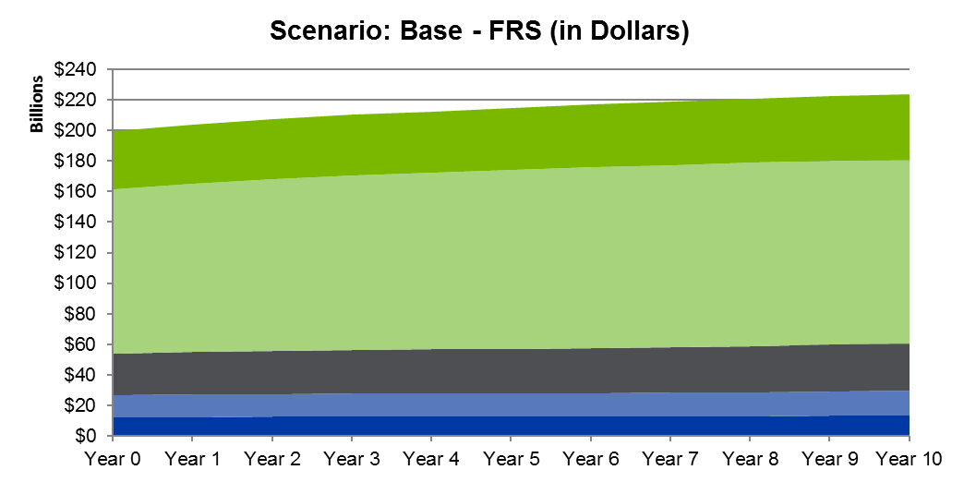
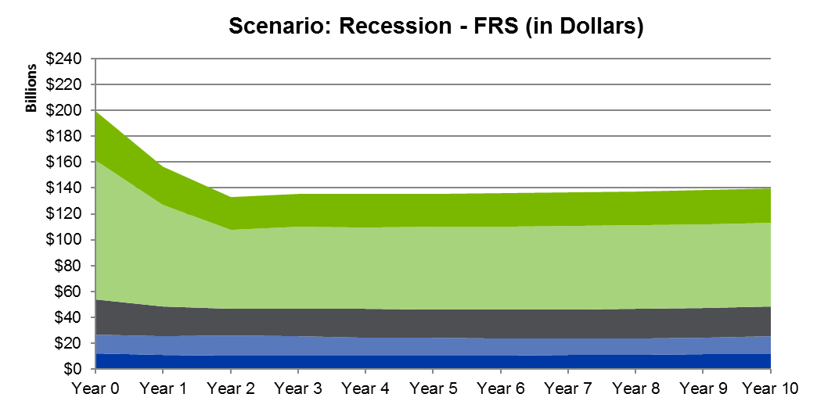
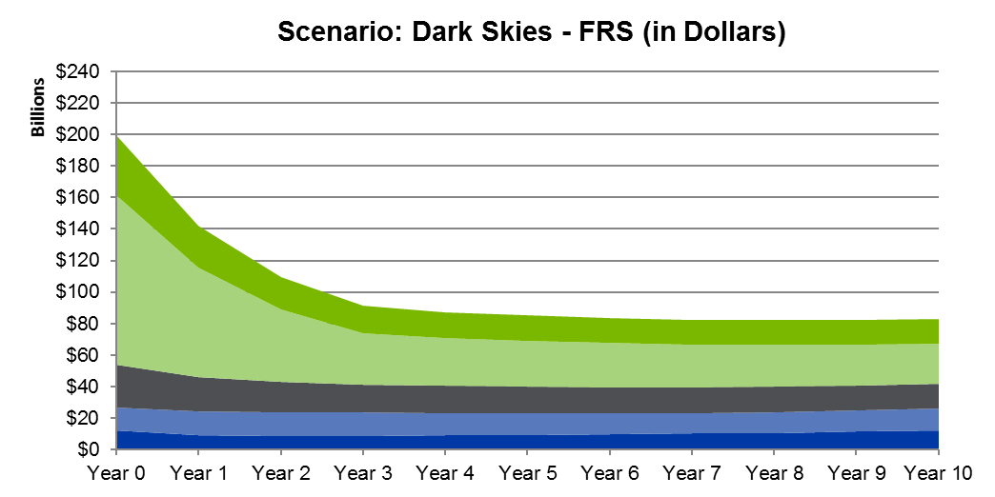
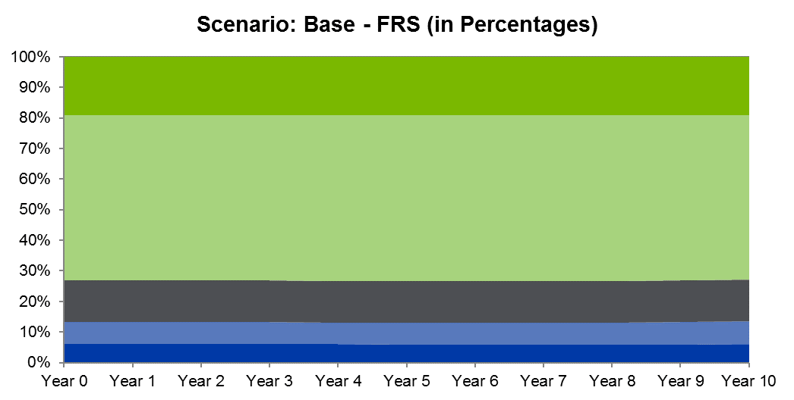
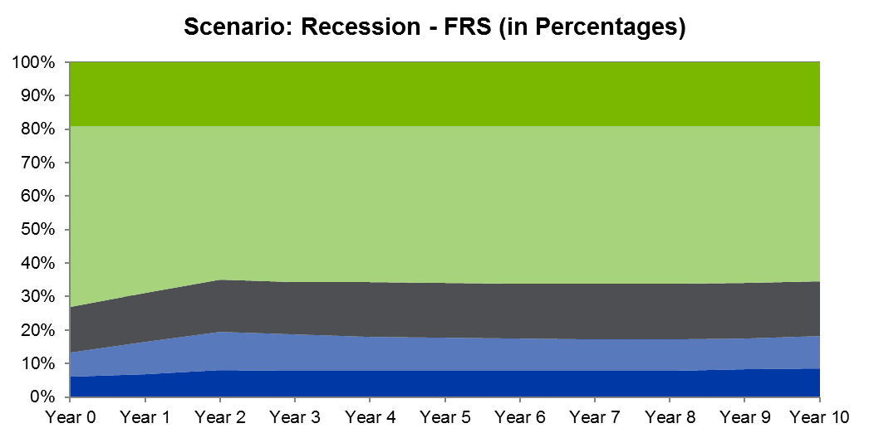
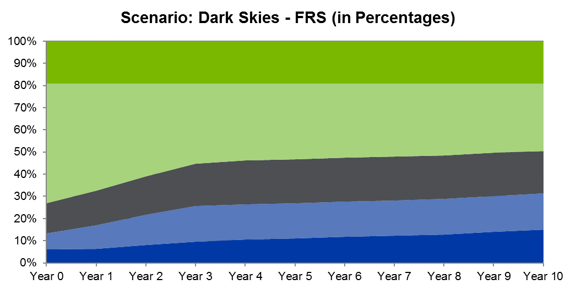
Liquidity Analysis | Summary of Results
Current Policy (Assuming Full Actuarial Contributions)
Base Case
Recession
Dark Skies
Note: Year 0 represents a starting point of June 30, 2021

Slide 38
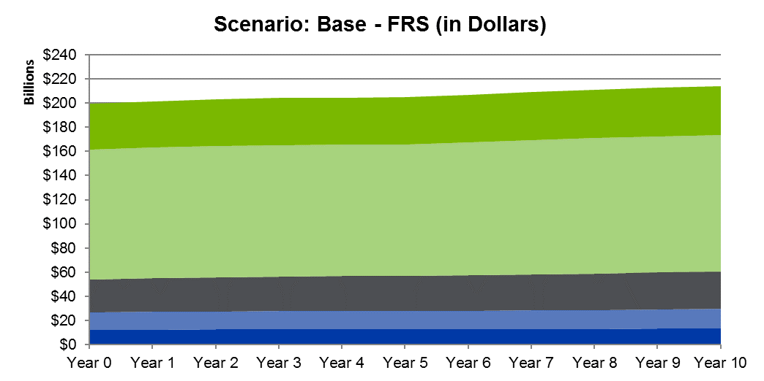
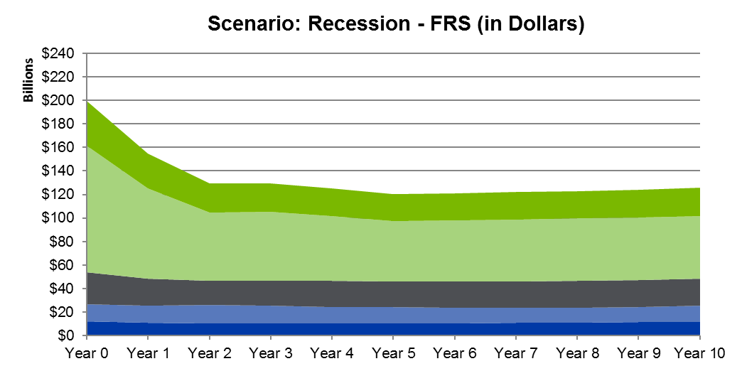
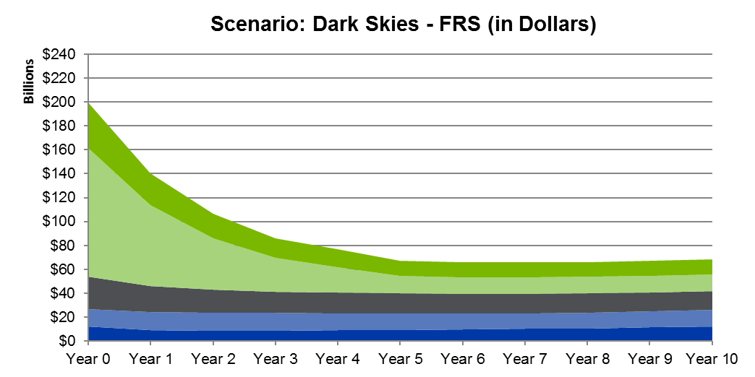
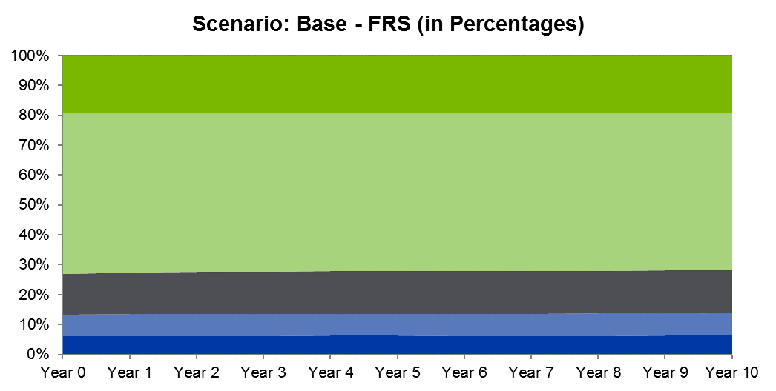
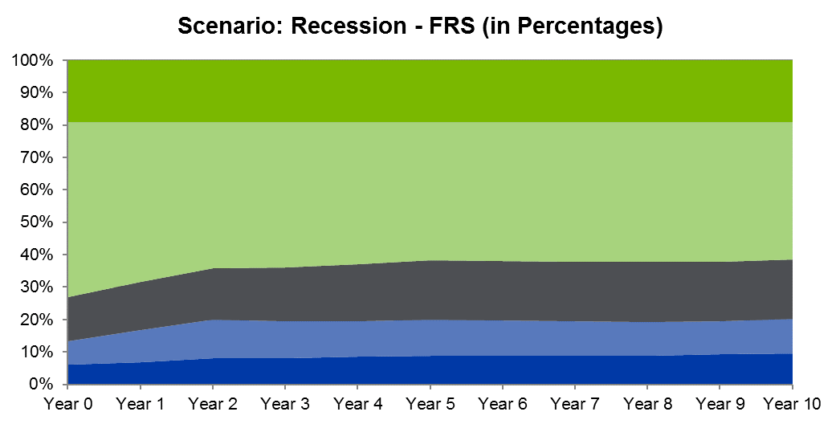
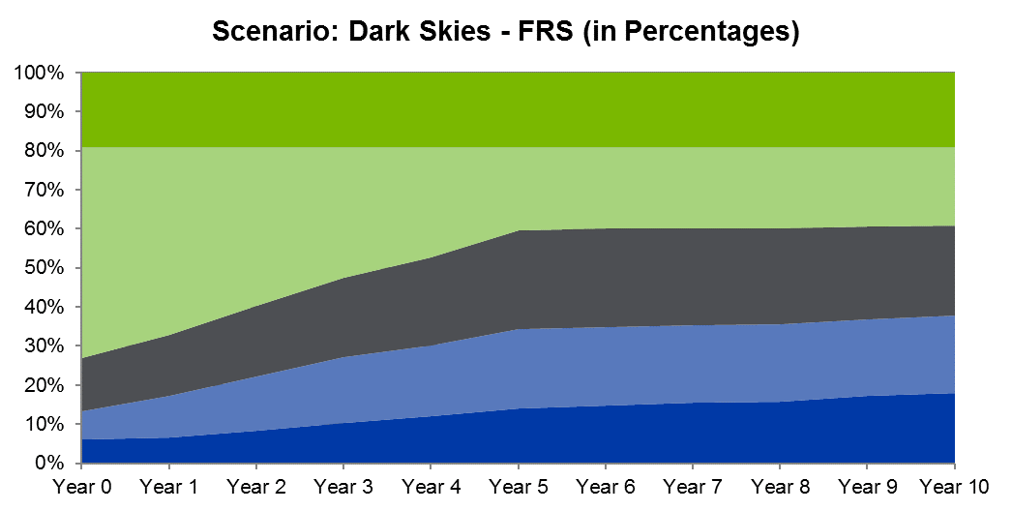
Liquidity Analysis | Summary of Results
Current Policy (5 Years of Normal Cost Only Contributions)
Base Case
Recession
Dark Skies
Note: Year 0 represents a starting point of June 30, 2021

Slide 39
Conclusions
FRS has sufficient liquidity in the modeled Base Case, Recession, and Dark Skies scenarios
  The total illiquid and quasi-liquid assets can be maintained near the target allocation with no cash flow problems
  In pessimistic scenarios, the allocation could drift enough from the target allocation that FRS may want to rebalance
This analysis is highly sensitive to the assumed contributions
  If FRS receives less contributions than assumed, especially in a Dark Skies environment, then illiquid investments drift even further from target and the potential for liquidity issues increases

Slide 40
Analysis
Public Pension Peer Comparison

Slide 41
Public Pension Peer Comparison
FRS’ Asset Allocation versus Public Peers
* Source: "Greenwich Associates - U.S. Institutional Investors 2020 - Market Trend Data Tables", Greenwich Associates
** Source: https://www.pionline.com/pension-funds/funding-ratio-state-pension-plans-slips-2020-wilshire

Slide 42
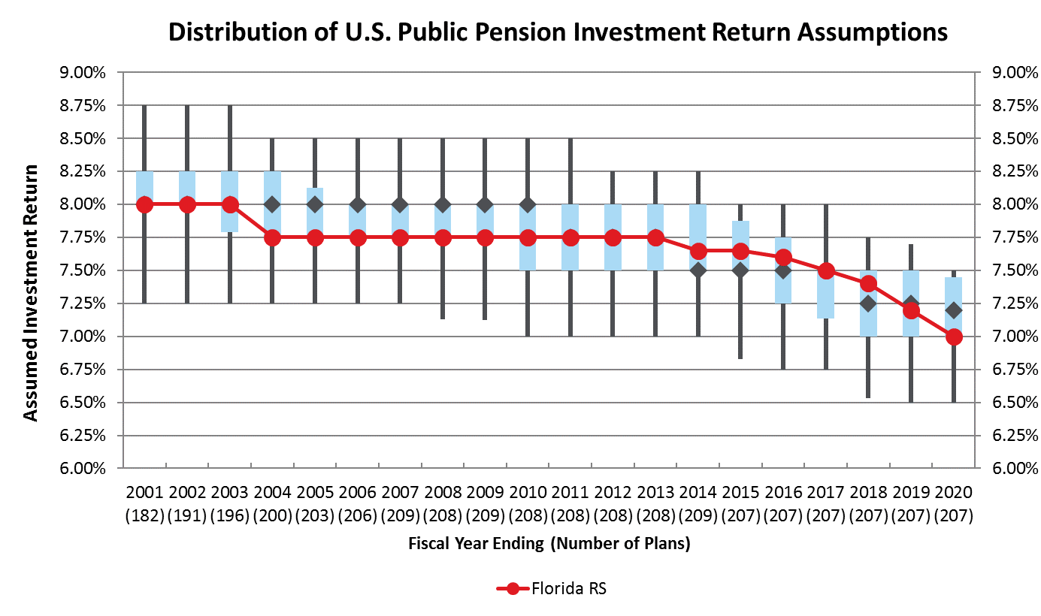
Florida Retirement System (FRS)
Expected Return Assumption versus Peers¹
Key Takeaways:
  Median actuarial assumption for investment return has declined from 8.00% in 2001-2010 to 7.20% based on the latest survey data
  FRS’ assumption for FYE 2020 (7.00%) fell at the 25th percentile relative to its peers
  If FRS exceeds (or falls short of) the actuarial return assumption, lower (or higher) funding will be needed in future years
Sources: Public Plans Data (publicplansdata.org) as of August 2021; Expected Returns are the assumptions made by the plans included in the data set.
¹ Peers defined as public funds published within publicplansdata.org as of August 2021; Number of plans per year are shown in parentheses

Slide 43
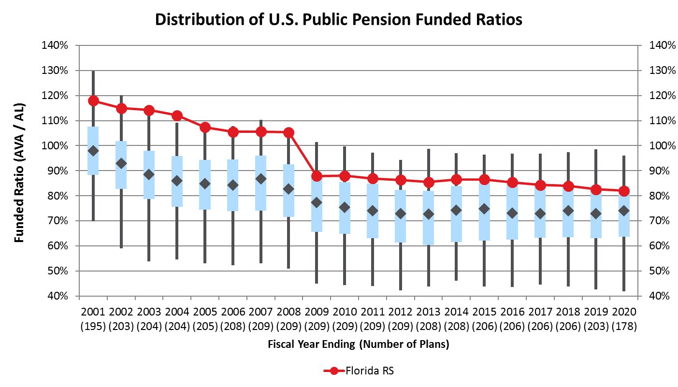
Florida Retirement System (FRS)
Funded Ratio (Based on Actuarial Value of Assets) versus Peers¹
Key Takeaways:
  The median funded ratio as of FYE 2020 was 74% based on the latest survey data
  FRS’ FYE 2020 funded ratio (82%) fell just below the 75th percentile relative to its peers
Sources: Public Plans Data (publicplansdata.org) as of August 2021
¹ Peers defined as public funds published within publicplansdata.org as of August 2021; Number of plans per year are shown in parentheses

Slide 44
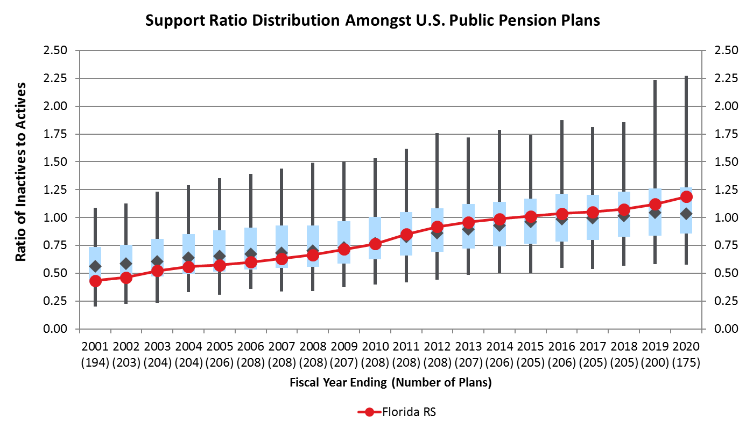
Florida Retirement System (FRS)
Support Ratio versus Peers¹
Key Takeaways:
  “Support Ratio” defined as the ratio of inactive participants to active participants
  The ability for new hires to elect the Investment Plan has subdued the increase in active employees, increasing the Support Ratio over time
Sources: Public Plans Data (publicplansdata.org) as of August 2021
¹ Peers defined as public funds published within publicplansdata.org as of August 2021; Number of plans per year are shown in parentheses

Slide 45
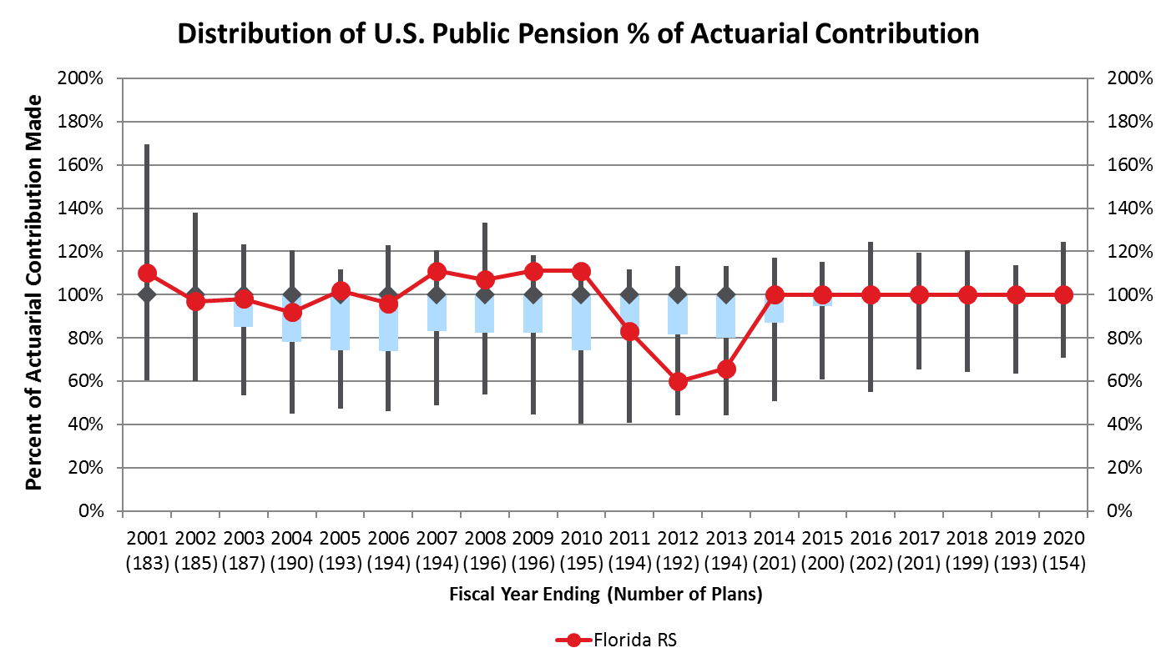
Florida Retirement System (FRS)
Percentage of Actuarial Contribution Made versus Peers¹
Key Takeaways:
  Median contributions of plans within the data, as a percentage of the actuarial amount, have been approximately 100% since FYE 2001
  FRS has made at least the full actuarial contribution in the last 7 fiscal years
Sources: Public Plans Data (publicplansdata.org) as of August 2021
¹ Peers defined as public funds published within publicplansdata.org as of August 2021; Number of plans per year are shown in parentheses

Slide 46
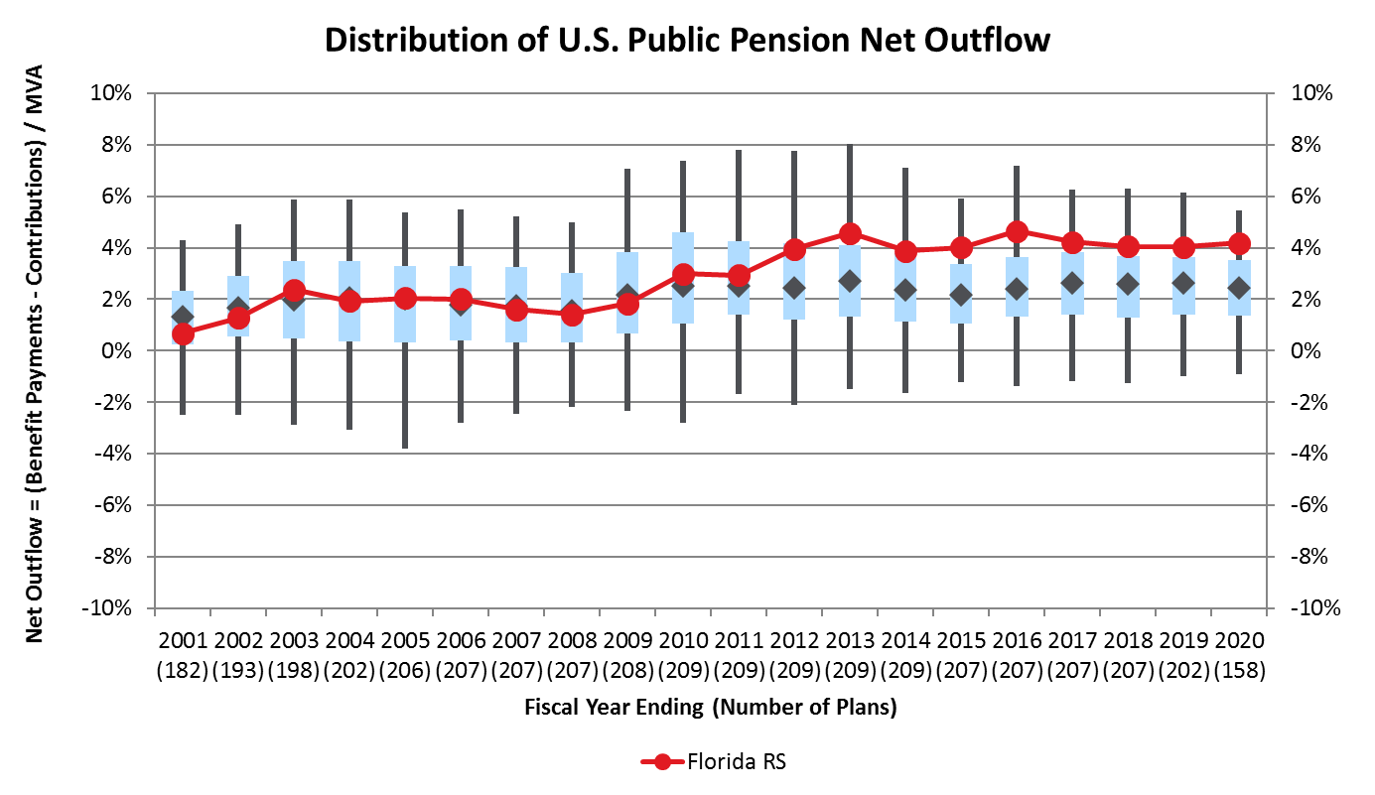
Florida Retirement System (FRS)
Net Outflow versus Peers¹
Key Takeaways:
  The median net outflow as of FYE 2020 was 2.4% based on the latest survey data
  FRS’ FYE 2020 net outflow (4.2%) fell between the 75th and 95th percentile relative to its peers
Sources: Public Plans Data (publicplansdata.org) as of August 2021
¹ Peers defined as public funds published within publicplansdata.org as of August 2021; Number of plans per year are shown in parentheses

Slide 47
Summary & Conclusions

Slide 48
Summary of Results
All Scenarios | 30-year Present Value of Gross |  | 30-year Ending
 | Contributions (Employee + Employer) |  | Funded Ratio (MVA / AL)
$ billions | Expected¹ | Downside² | Expected¹ | Downside³
Current Policy (81% R-S) | $69.9 | $136.2 | 102% | 35%
Current Frontier
0% Return-Seeking | $112.3 | $118.6 | 40% | 29%
10% Return-Seeking | $106.6 | $117.4 | 43% | 30%
20% Return-Seeking | $100.8 | $118.5 | 47% | 32%
30% Return-Seeking | $95.1 | $120.7 | 52% | 32%
40% Return-Seeking | $89.7 | $123.5 | 59% | 33%
50% Return-Seeking | $84.2 | $126.4 | 67% | 34%
60% Return-Seeking | $78.9 | $129.2 | 77% | 34%
70% Return-Seeking | $74.1 | $132.3 | 88% | 35%
80% Return-Seeking | $70.0 | $135.7 | 101% | 35%
90% Return-Seeking | $66.7 | $139.0 | 116% | 36%
100% Return-Seeking | $64.2 | $142.4 | 131% | 36%
Key Observations:
The funded ratio is expected to increase initially before remaining relatively flat over the projection period under the Current Policy
Employer contribution rate is expected to decline initially, gradually increase over the next two decades, and then eventually decline
Adjusting the return-seeking vs. risk-reducing allocation will exhibit standard risk/reward trade-off of expected costs and risks – longer time horizons will incentivize higher allocations to return-seeking assets
¹ Expected = 50th percentile outcome or central expectation across all 5,000 simulations
² Downside = 95th percentile outcome across all 5,000 simulations
³ Downside = 5th percentile outcome across all 5,000 simulations

Slide 49
Summary and Conclusions
Investment
Analysis
  We believe the current portfolio is well-diversified with 81% return-seeking assets
  The equity risk premium is 3.92% in this 2021 Asset-Liability Study, compared to 5.15% from 2020; the change is driven by the combination of lower projected equity returns and higher fixed income returns year-over-year
  Asset returns (6.13%) are not expected to keep pace with the actuarial assumed rate of return (7.00%)
Asset-Liability
Projection
Analysis
  Longer time horizons are expected to reward higher levels of risk; shorter time horizons are not
  The funded ratio is expected to improve with FYE 2021 returns and then remain relatively flat over the course of the projection period in our central expectation (50th percentile outcome)
  Adverse market experience could significantly impact the funded status of the Plan over the projection period, albeit with low likelihood
Liquidity
Analysis
  The current portfolio is projected to have sufficient liquidity in the modeled Base, Recession, and Dark Skies scenarios

Slide 50
Appendix
Assumptions & Methods

Slide 51
Actuarial Assumptions and Methods
  Based on actuarial valuation and projections provided by the plan actuary as of July 1, 2020
  Actuarial Assumptions
    Valuation Rate of Interest = 7.00%
    Inflation = 2.40%
    Payroll Growth = 3.25%
    Actuarial Value of Assets: Reflects a five-year averaging methodology where 20% of the difference between the actual market value and the expected actuarial value of assets is immediately recognized but restricted to a 20% corridor around the Market Value of Assets
    All other assumptions as documented in the Actuarial Valuation Report as of July 1, 2020, unless noted otherwise
  Actuarially Determined Contribution Calculation = Normal Cost plus a level percent amortization of the unfunded liability using a 3.25% salary scale
    New amortization bases are established each year, creating a layered 25-year amortization base

Slide 52
Actuarial Assumptions and Methods (continued)
  Blended Contribution Rate = projected combined amount that would be contributed for both the FRS Pension Plan and the FRS Investment Plan based on the total projected payroll for both plans
    FRS Investment Plan employer rate is assumed to remain level at 4.70%
  Employee contribution rate is assumed to remain level at 3.00%
  Projection assumptions:
    Future benefit payments and payroll projections (used for GASB 67 purposes) were supplied by the plan actuary and used in our analysis
    Per Staff request, 35% of new entrants are assumed to elect the pension plan with 90% of Special Risk new entrants electing the pension plan and approximately 26% of new entrants from other groups electing the pension plan
    Actual asset experience was factored in using an asset value of $199.6 billion as of June 30, 2021

Slide 53
Actuarial Assumptions and Methods (continued)
Blended Contribution Rate
  Combined projected contributions for both the FRS Pension Plan and the FRS Investment Plan as percentage of total system payroll
    Blended Employer Contribution Rate is less than Pension Plan Employer Contribution Rate since UAL amortization is divided by total payroll rather than pension only payroll
Pension Plan Employer Contribution Rate
Penson Plan Employer Normal Cost Rate¹
UAL Contribution Rate
Blended Employer Normal Cost Rate
Blended UAL Contribution Rate
Pension Plan
Investment Plan
Pension Plan
Blended Employer Contribution Rate
(Employer Normal Cost Rate¹
x Payroll)
(Employer Rates x Payroll)
(UAL Rate
x UAL Payroll)
Total System Payroll
Total System Payroll
¹ Net of expected employee contribution rate of 3.00%

Slide 54
Capital Market Assumption Methodology
The Aon Asset Model and Economic Scenario Generator (ESG) creates 5,000 simulations of key economic variables and total returns.
We believe the model is complete and consistent. All the major markets and asset classes are modeled within a consistent framework allowing for the interactions between them to be properly taken into account.
It is arbitrage free and captures the fact that extreme market events do occur more frequently than would be predicted by simpler statistical models.
The ESG models the full yield curve as this allows for accurate treatment of liabilities and realistic modeling of the future distribution of interest rates and inflation. This allows us to assess the sensitivities of assets and liabilities to changes in interest and inflation rates.
The model is calibrated to Aon's globally-consistent Capital Market assumptions every quarter.
Nominal and real government interest rates are projected using an extended two factor Black-Karasinki model and a 2 factor Vasicek model respectively. The models are mean reverting starting with current yield curves and reverting towards our long-term fair values over the very long-term.
Credit spreads are modeled stochastically using a Markov based model to determine the probabilities of transition between various credit rating and default, and a stochastic parameter reflecting the level of risk aversion in the market.
Return seeking assets (including equities) are modeled using an individual asset class model with its own returns and volatilities but no correlations to other asset classes, and exposure to 6 other economic models to gain the correct correlation structures between returns for each asset class.

Slide 55
Custom FRS Capital Market Assumptions—Q3 2021¹
 |  | Expected Real Return¹ | Expected Nominal Return¹ | Expected Nominal Volatility
 | Equity
1 | Global Equity IMI | 4.2% | 6.4% | 19.0%
 | Fixed Income
2 | Cash (Gov't) | -0.2% | 1.9% | 1.5%
3 | Intermediate Gov't Bonds (4-Year Duration) | -0.2% | 1.9% | 3.5%
4 | Intermediate Corporate Bonds (4-Year Duration) | 0.7% | 2.8% | 4.5%
 | Alternatives
5 | Strategic Allocation (Custom) | 4.9% | 7.1% | 9.0%
6 | Real Estate (Custom) | 3.1% | 5.3% | 16.0%
7 | Private Equity | 5.8% | 8.0% | 25.5%
 | Inflation
8 | Inflation | 0.0% | 2.1% | 1.5%
¹ Expected return assumptions are based upon the Aon Investments’ capital market assumptions adjusted for the delta in Global Equity Risk Premium (ERP) among three investment advisors: Mercer, Wilshire, and Aon Investments (-63bps adjustment)
² Strategic assumption breakdown is found on the next page
³ Real Estate assumption was modeled as follows:
  76.50% Core Real Estate
  13.50% Non-Core Real Estate
  10.00% REITs

Slide 56
FRS Capital Market Assumptions—Q3 2021
Strategic Investment Allocation
The Strategic Investment allocation was modeled as follows, per Staff input:
Capital Market Assumption | % of Total Asset Allocation | % of Strategic Investment
Commodities | 0.36% | 3.00%
Global Public Equities | 1.20% | 10.00%
Hedge Funds - Buy List (Diversified Portfolio of Direct HFs) | 1.68% | 14.00%
Hedge Funds - CTAs (Buy List) | 0.96% | 8.00%
Hedge Funds - Distressed Debt (Buy List) | 0.36% | 3.00%
Hedge Funds - Equity Long/Short (Buy List) | 0.36% | 3.00%
Hedge Funds - Event Driven (Buy List) | 0.12% | 1.00%
Hedge Funds - Global Macro (Buy List) | 0.24% | 2.00%
Infrastructure | 1.20% | 10.00%
Insurance-Linked Securities (Catastrophe Bonds) | 0.96% | 8.00%
Non-Core Real Estate | 0.30% | 2.50%
Private Debt - Commercial Mortgages | 0.30% | 2.50%
Private Debt - Direct Lending | 0.72% | 6.00%
Private Equity | 0.72% | 6.00%
Private Equity - Distressed Debt | 1.44% | 12.00%
Private Equity - Mezzanine | 0.72% | 6.00%
Timberland | 0.36% | 3.00%
Total | 12.00% | 100.00%

Slide 57
Aon Investments’ Capital Market Assumptions—Q3 2021
 | Nominal Correlations | 1 | 2 | 3 | 4 | 5 | 6 | 7 | 8
1 | Global Equity IMI | 1.00 | 0.07 | -0.08 | 0.05 | 0.89 | 0.46 | 0.67 | 0.09
2 | Cash (Gov't) | 0.07 | 1.00 | 0.58 | 0.50 | 0.10 | 0.13 | 0.08 | 0.42
3 | Intermediate Gov't Bonds (4-Year Duration) | -0.08 | 0.58 | 1.00 | 0.82 | -0.08 | 0.02 | -0.05 | 0.08
4 | Intermediate Corporate Bonds (4-Year Duration) | 0.05 | 0.50 | 0.82 | 1.00 | 0.17 | 0.07 | 0.05 | 0.06
5 | Strategic Allocation (Custom) | 0.89 | 0.10 | -0.08 | 0.17 | 1.00 | 0.48 | 0.71 | 0.13
6 | Real Estate (Custom) | 0.46 | 0.13 | 0.02 | 0.07 | 0.48 | 1.00 | 0.37 | 0.09
7 | Private Equity | 0.67 | 0.08 | -0.05 | 0.05 | 0.71 | 0.37 | 1.00 | 0.07
8 | Inflation | 0.09 | 0.42 | 0.08 | 0.06 | 0.13 | 0.09 | 0.07 | 1.00

Slide 58
Aon Investments’ Capital Market Assumptions
Explanation of Capital Market Assumptions—Q3 2021 (30 Years)
The following capital market assumptions were developed by Aon’s Global Asset Allocation Team and represent the long-term capital market outlook (i.e., 30 years) based on data at the end of the second quarter of 2021. The assumptions were developed using a building block approach, reflecting observable inflation and interest rate information available in the fixed income markets as well as Consensus Economics forecasts. Our long-term assumptions for other asset classes are based on historical results, current market characteristics, and our professional judgment.
Inflation – Expected Level (2.1%)
Based on Consensus Economics long-term estimates and our near-term economic outlook, we expect U.S. consumer price inflation to be approximately 2.1% during the next 30 years.
Real Returns for Asset Classes
Fixed Income
Cash (-0.2%) – Over the long run, we expect the real yield on cash and money market instruments to produce a real return of -0.2% in a moderate to low-inflationary environment.
TIPS (-0.03) – We expect intermediate duration Treasury Inflation-Protected Securities to produce a real return of about -0.3%.
Core Fixed Income (i.e., Market Duration) (0.4%) – We expect intermediate duration Treasuries to produce a real return of about -0.2%. We estimate the fair value credit spread (credit risk premium - expected losses from defaults and downgrades) to be 0.6%, resulting in a long-term real return of 0.4%.
Long Duration Bonds – Government and Credit (0.5%) – We expect Treasuries with a duration comparable to the Long Government Credit Index to produce a real return of 0.0%. We estimate the fair value credit spread (credit risk premium - expected losses from defaults and downgrades) to be 0.5%, resulting in an expected real return of 0.5%.

Slide 59
Aon Investments’ Capital Market Assumptions
Explanation of Capital Market Assumptions—Q3 2021 (30 Years)
Long Duration Bonds – Credit (0.8%) – We expect Treasuries with a duration comparable to the Long Credit Index to produce a real return of 0.0%. We estimate the fair value credit spread (credit risk premium - expected losses from defaults and downgrades) to be 0.8, resulting in an expected real return of 0.8%.
Long Duration Bonds – Government (0.0%) – We expect Treasuries with a duration of ~12 years to produce a real return of 0.0% during the next 30 years.
High Yield Bonds (2.4%) – We expect intermediate duration Treasuries to produce a real return of about -0.2%. We estimate the fair value credit spread (credit risk premium - expected losses from defaults and downgrades) to be 2.6%, resulting in an expected real return of 2.4%.
Bank Loans (2.8%) – We expect LIBOR to produce a real return of about 0.1%. We estimate the fair value credit spread (credit risk premium - expected losses from defaults) to be 2.7%, resulting in an expected real return of 2.8%.
Non-US Developed Bonds: 50% Hedged (-0.1%) – We forecast real returns for non-US developed market bonds to be -0.1% over a 30-year period after adjusting for a 50% currency hedge. We assume a blend of one-third investment grade corporate bonds and two-thirds government bonds. We also produce assumptions for 0% hedged and 100% hedged non-US developed bonds.
Emerging Market Bonds (Sovereign; USD) (2.2%) – We forecast real returns for emerging market sovereign bonds denominated in US dollars to be 2.2% over a 30-year period.
Emerging Market Bonds (Corporate; USD) (2.1%) – We forecast real returns for emerging market corporate bonds denominated in US dollars to be 2.1% over a 30-year period.
Emerging Market Bonds (Sovereign; Local) (2.1%) – We forecast real returns for emerging market sovereign bonds denominated in local currency to be 2.1% over a 30-year period.

Slide 60
Aon Investments’ Capital Market Assumptions
Explanation of Capital Market Assumptions—Q3 2021 (30 Years)
Multi Asset Credit (MAC) (3.4%) – We assume real returns from beta exposure to high yield, bank loans and emerging market debt to add 2.6% plus 0.8% from alpha (net of fees) over a 30-year period.
Private Debt-Direct Lending (3.9%) – The base building block is bank loans 2.8% + spread 3.0% (net of management fees and performance incentives). There is 100% leverage included in the assumption with the nominal cost of financing at LIBOR + 2.5%.
Equities
Large Cap U.S. Equity (4.1%) – This assumption is based on our 30-year outlook for large cap U.S. company dividends and real earnings growth. Adjustments are made for valuations as needed.
Small Cap U.S. Equity (4.6%) – Adding a 0.5% return premium for small cap U.S. equity over large cap U.S. equity results in an expected real return of 4.6%. This return premium is theoretically justified by the higher risk inherent in small cap U.S. equity versus large cap U.S. equity and is also justified by historical data. In recent years, higher small cap valuations relative large cap equity has reduced the small cap premium.
Global Equity (Developed & Emerging Markets) (4.8%) – We employ a building block process similar to the U.S. equity model using the developed and emerging markets that comprise the MSCI All-Country World Index. Our roll-up model produces an expected real return of 4.8% for global equity.
International (Non-U.S.) Equity, Developed Markets (4.8%) – We employ a building block process similar to the U.S. equity model using the non-U.S. developed equity markets that comprise the MSCI EAFE Index.
Emerging Market Stocks (5.3%) – We employ a building block process similar to the U.S. equity model using the non-U.S. emerging equity markets that comprise the MSCI Emerging Markets Index.

Slide 61
Aon Investments’ Capital Market Assumptions
Explanation of Capital Market Assumptions—Q3 2021 (30 Years)
Equity Risk Insurance Premium Strategies-High Beta (3.3%) – We expect real returns from 50% equity + 50% cash beta of 2.3% plus 1.0% insurance risk premium over the next 30 years.
Alternative Asset Classes
Hedge Fund-of-Funds Universe (1.5%) – The generic category “hedge funds” encompasses a wide range of strategies accessed through “fund-of-funds” vehicles. We also assume the median manager is selected and also allow for the additional costs associated with Fund-of-Funds management. A top-tier portfolio of funds (hedge fund-of-funds buy-list) could add an additional 1.2% in return at similar volatility based on alpha, lower fees and better risk management.
Hedge Fund-of-Funds Buy List (2.6%) – The generic category of top-tier “hedge funds” encompasses a wide range of strategies accessed through “fund-of-funds” vehicles. We assume additional costs associated with Funds-of-Funds management. To use this category the funds must be buy rated or we advise on manager selection.
Broad Hedge Funds Universe (2.8%) – Represents a diversified portfolio of direct hedge fund investments. This investment will tend to be less diversified than a typical “fund-of-funds” strategy as there will be fewer underlying managers and will not include the extra layer of fees found in a Fund-of-Funds structure.
Broad Hedge Funds Buy List (4.1%) – Represents a diversified portfolio of top-tier direct hedge fund investments. This investment will tend to be less diversified than a typical “fund-of-funds” strategy as there will be fewer underlying managers and will not include the extra layer of fees found in a Fund-of-Funds structure. To use this category the funds must be buy rated or we advise on manager selection.
Core Real Estate (3.3%) – Our real return assumption for core real estate is based a gross income of about 3.5%, management fees of roughly 1%, 25% leverage and future capital appreciation near the rate of inflation during the next 30 years. We assume a portfolio of equity real estate holdings that is diversified by property and by geographic region.

Slide 62
Aon Investments’ Capital Market Assumptions
Explanation of Capital Market Assumptions—Q3 2021 (30 Years)
Non-Core Real Estate (5.1%) – Core real estate is levered approximately 100% as the base building block for this assumption. We subtract financing costs for the leverage and 2% management costs. We also assume nominal alpha of 3%. We assume a 50/50 mix of value-add and opportunistic investments.
U.S. REITs (2.9%) – Our real return assumption for U.S. REITs is based on income of about 3.5% and future capital appreciation near the rate of inflation during the next 30 years. REITs are a sub-set of U.S. small/mid cap equity universe.
Commodities (2.3%) – Our commodity assumption is for a diversified portfolio of commodity futures contracts. Commodity futures returns are composed of three parts: spot price appreciation, collateral return, and roll return (positive or negative change implied by the shape of the future curve). We believe that spot prices will converge with CPI over the long run (i.e., 2.1%). Collateral is assumed to be LIBOR cash (0.1%). Also, we believe the roll effect will be near zero, resulting in a real return of about 2.3% for commodities.
Private Equity (6.5%) – Our private equity assumption reflects a diversified fund of funds with exposure to buyouts, venture capital, distressed debt, and mezzanine debt.
Infrastructure (4.9%) – Our infrastructure assumption is formulated using a cash flow based approach that projects cash flows (on a diversified portfolio of assets) over a 30-year period. Income and capital growth as well as gearing levels, debt costs and terms, relevant tax and management expenses are all taken into consideration. Our approach produces an expected real return of 4.9% for infrastructure.
Equity Risk Insurance Premium Strategies-Low Beta (2.3%) – We assume real returns from cash of -0.2% + 2.5% from alpha.
Alternative Risk Premia (ARP) (4.0%) – Real return target LIBOR 0.1% plus 3.9% alpha (net of fees)
eLDI (1.6%) – Combination of various long credit strategies (1/6 real estate debt, 1/3 securitized debt, 1/6 CMOs, 1/3 private placements)

Slide 63
Aon Investments’ Capital Market Assumptions
Explanation of Capital Market Assumptions—Q3 2021 (30 Years)
Volatility / Correlation Assumptions
Assumed volatilities are formulated with reference to implied volatilities priced into option contracts of various terms, as well as with regard to historical volatility levels. For asset classes which are not marked to market (for example real estate), we “de-smooth” historical returns before calculating volatilities. Importantly, we consider expected volatility trends in the future – in recent years we assumed the re-emergence of an economic cycle and a loss of confidence in central bankers would lead to an increase in volatility. Correlation assumptions are generally similar to actual historical results; however, we do make adjustments to reflect our forward-looking views as well as current market fundamentals.

Slide 64
Appendix
2021 Horizon Survey of Capital Market Assumptions

Slide 65
2021 Horizon Survey Results
What is the Horizon Survey?
  Since 2010, Horizon Actuarial Services, LLC has conducted a capital market assumption survey of investment firms to aid in determining reasonable assumptions for a pension plan’s expected return on assets
  While Aon does not seek to change our approach based on how we stack up to peers, it is a helpful double-check to make sure we are not too far off from others in the industry
How does Aon compare to the 2021 survey results?
  Aon Investments’ 2021 10-year forecast assumptions (as of March 31, 2021)
  Equities: approximately middle of the pack for U.S. and Non-U.S. equities
  Fixed Income: approximately middle of the pack relative to the survey’s median level; higher for U.S. Treasuries
  Alternatives: approximately middle of the pack relative to the survey’s median level; higher for Commodities and Private Debt

Slide 66
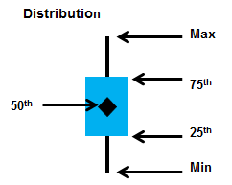
Aon Investments’ Capital Market Assumptions vs. Horizon Survey
SOURCE: Horizon Actuarial Solutions, LLC survey of 2021 capital market assumptions from 39 independent investment advisors
Expected returns of the survey are annualized over 10-years (geometric).
Aon Investments’ expected returns are annualized over 10-years as of 2Q 2021 (3/31/2021)

Slide 67
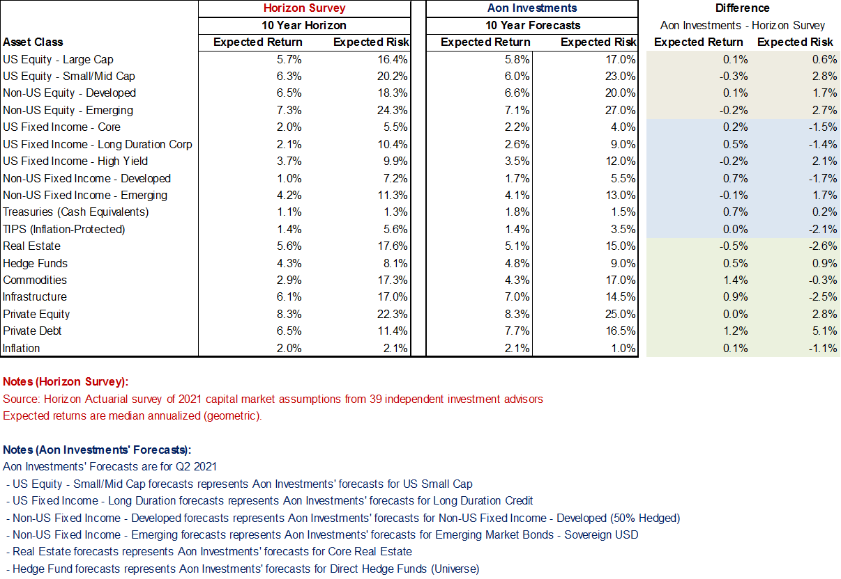
Aon Investments vs. Peers (2021 Horizon Survey)—10-Year Forecast

Slide 68
Leading Methodologies & Reasons for Differences
Leading Methodologies
Building Block
Reasons for Differences
Methodology
Global Capital Asset Pricing Model (Global CAPM)
Surveys
Historical data (as a guide to future)
Black-Litterman (combination of building block and CAPM)
Time Horizon
Arithmetic vs. Geometric forecasts*
Alpha (active management)*
Inflation
Investment Fees*
Asset class definition
* While some firms in the Horizon survey responded with arithmetic forecasts, the results have been converted to geometric forecasts for comparison purposes. Additionally, the return expectations included in the Horizon survey are generally market returns that do not reflect active management. Returns for asset classes where passive investments are not available (e.g., hedge funds and private equity) are net of fees.

Slide 69
Appendix
Liquidity Analysis Detail

Slide 70
Background
Aon Investments’ Approach to Analyzing Liquidity Risk from Alternatives
Intended as a stress-testing model
Develops multi-year projections of assets and spending needs
Uses different scenarios for economic environments and other relevant events
Shows how the portfolio’s liquidity profile could evolve with a given investment strategy
Incorporates the profile of the liabilities as well as expected future contributions

Slide 71
Background
Process Inputs and Outputs
Asset Allocation
Liquidity Profile
Investment Strategy
Economic Scenarios
Contributions
Benefit Payments

Slide 72
Background
Modeling Parameters – Degrees of Illiquidity
We categorized investments by liquidity into five buckets
  Liquid (Risk-Reducing Assets): less than 3 months needed for return of capital (e.g., publicly traded securities)
  Liquid (Return-Seeking Assets): less than 3 months needed for return of capital (e.g., publicly traded securities)
  Quasi-Liquid: Typical lock-up of 3–12 months. Conservatively, we assumed a 1-year lock-up in most economic environments,
  2 years in a Recession scenario, and 3 years in a Dark Skies scenario (e.g., many hedge funds, core real estate)
  Illiquid: Potential lock-up of 5–10 years, depending on economic environment (e.g., closed-ended real estate)
  Illiquid: Potential lock-up of 10+ years (e.g., typical private equity)
This is intended to be a conservative approximation of the actual liquidity properties of the assets
We started with the Current Policy allocation, then see how the actual allocations would change in different economic scenarios, continuing new commitments to private assets, as expected.
Assumptions
  Starting assets based on the reported June 30, 2021 ($199.6 billion)
  The plan’s contribution policy is actuarially based, leveraging the 2021 asset-liability study for projection analysis
  Assumes the portfolio starts at the target asset allocation levels for illiquid assets, maintaining close to the Current
  Policy portfolio targets over the next 10 years

Slide 73
Background
Economic Scenarios
Base Case Scenario
  Markets perform consistent with Aon’s Capital Market Assumptions (~50th percentile)
Recession Scenario
Somewhat pessimistic outlook for the markets (~95th percentile)
Return-seeking assets decline in the first two years with a modest rebound in later years
Dark Skies Scenario
  Very pessimistic outlook for markets (~99th percentile)
  Return-seeking assets decline significantly
  The value of public equities declines approximately 50% over three years, without an immediate rebound

Slide 74
Liquidity Analysis: Base Case Economic Scenario
Current Policy (Assuming Full Actuarial Contributions)
The exhibit below shows the projected liquidity lock-up of the Current Policy allocation in the Base Case economic scenario, assuming commitments are continued as expected
Key Takeaway:
  Total illiquid and quasi-liquid assets are projected to stay near 27% of the Plan and can be maintained near the target with no cash flow problems
Note: Year 0 represents a starting point of June 30, 2021

Slide 75
Liquidity Analysis: Base Case Economic Scenario (continued)
Current Policy (Assuming Full Actuarial Contributions)
The exhibit below shows the projected liquidity lock-up of the Current Policy allocation in the Base Case economic scenario
Asset Allocation | Year 0 | Year 1 | Year 2 | Year 3 | Year 4 | Year 5 | Year 6 | Year 7 | Year 8 | Year 9 | Year 10
Risk-Reducing Assets | 19% | 19% | 19% | 19% | 19% | 19% | 19% | 19% | 19% | 19% | 19%
Liquid Return-Seeking | 54 | 54 | 54 | 54 | 54 | 54 | 54 | 54 | 54 | 54 | 54
Total Liquid | 73% | 73% | 73% | 73% | 73% | 73% | 73% | 73% | 73% | 73% | 73%
Quasi-Liquid | 14% | 14% | 14% | 14% | 14% | 14% | 14% | 14% | 14% | 14% | 14%
Illiquid: 5-10 Year Lock-up | 7 | 7 | 7 | 7 | 7 | 7 | 7 | 7 | 7 | 7 | 7
Illiquid: 10+ Year Lock-up | 6 | 6 | 6 | 6 | 6 | 6 | 6 | 6 | 6 | 6 | 6
Total Quasi + Illiquid | 27% | 27% | 27% | 27% | 27% | 27% | 27% | 27% | 27% | 27% | 27%
Note: Year 0 represents a starting point of June 30, 2021; Percentages may not sum to 100% due to rounding

Slide 76
Liquidity Analysis: Recession Economic Scenario
Current Policy (Assuming Full Actuarial Contributions)
The exhibit below shows the projected liquidity lock-up of the Current Policy allocation in the Recession economic scenario, assuming commitments are continued as expected
Key Takeaways:
  Commitments to illiquid alternatives are maintained at the steady state level, but recessionary markets cause the total portfolio to shrink
  Total illiquid and quasi-liquid assets are projected to reach as high as 35% of the Plan due to shrinking market value of the total Plan in this scenario
  There would not be a concern with the ability to pay benefits
  FRS may need to redeem some quasi-liquid assets to stay close to its target allocation
Note: Year 0 represents a starting point of June 30, 2021

Slide 77
Liquidity Analysis: Recession Economic Scenario (continued)
Current Policy (Assuming Full Actuarial Contributions)
The exhibit below shows the projected liquidity lock-up of the Current Policy allocation in the Recession economic scenario
Asset Allocation | Year 0 | Year 1 | Year 2 | Year 3 | Year 4 | Year 5 | Year 6 | Year 7 | Year 8 | Year 9 | Year 10
Risk-Reducing Assets | 19% | 19% | 19% | 19% | 19% | 19% | 19% | 19% | 19% | 19% | 19%
Liquid Return-Seeking | 54 | 50 | 46 | 47 | 47 | 47 | 47 | 47 | 47 | 47 | 46
Total Liquid | 73% | 69% | 65% | 66% | 66% | 66% | 66% | 66% | 66% | 66% | 65%
Quasi-Liquid | 14% | 15% | 15% | 16% | 16% | 16% | 16% | 16% | 17% | 16% | 16%
Illiquid: 5-10 Year Lock-up | 7 | 10 | 12 | 11 | 10 | 10 | 10 | 9 | 9 | 9 | 10
Illiquid: 10+ Year Lock-up | 6 | 7 | 8 | 8 | 8 | 8 | 8 | 8 | 8 | 8 | 8
Total Quasi + Illiquid | 27% | 31% | 35% | 34% | 34% | 34% | 34% | 34% | 34% | 34% | 35%
Note: Year 0 represents a starting point of June 30, 2021; Percentages may not sum to 100% due to rounding

Slide 78
Liquidity Analysis: Dark Skies Economic Scenario
Current Policy (Assuming Full Actuarial Contributions)
The exhibit below shows the projected liquidity lock-up of the Current Policy allocation in the Dark Skies economic scenario, assuming commitments are continued as expected
Key Takeaways:
  Commitments to illiquid alternatives are maintained at the steady state level, but subpar markets cause the total portfolio to shrink
  Total illiquid and quasi-liquid assets are projected to reach as high as 51% of the Plan due to shrinking market value of the total Plan in this scenario
  There would not be a concern with the ability to pay benefits
  FRS may need to redeem some quasi-liquid assets and/or pare back future commitments to stay closer to the target allocation
Note: Year 0 represents a starting point of June 30, 2021

Slide 79
Liquidity Analysis: Dark Skies Economic Scenario (continued)
Current Policy (Assuming Full Actuarial Contributions)
The exhibit below shows the projected liquidity lock-up of the Current Policy allocation in the Dark Skies economic scenario
Asset Allocation | Year 0 | Year 1 | Year 2 | Year 3 | Year 4 | Year 5 | Year 6 | Year 7 | Year 8 | Year 9 | Year 10
Risk-Reducing Assets | 19% | 19% | 19% | 19% | 19% | 19% | 19% | 19% | 19% | 19% | 19%
Liquid Return-Seeking | 54 | 49 | 42 | 36 | 35 | 34 | 34 | 33 | 33 | 31 | 30
Total Liquid | 73% | 68% | 61% | 55% | 54% | 53% | 53% | 52% | 52% | 50% | 49%
Quasi-Liquid | 14% | 16% | 18% | 19% | 20% | 20% | 20% | 20% | 20% | 19% | 19%
Illiquid: 5-10 Year Lock-up | 7 | 10 | 14 | 16 | 16 | 16 | 16 | 16 | 16 | 16 | 16
Illiquid: 10+ Year Lock-up | 6 | 6 | 8 | 10 | 10 | 11 | 12 | 12 | 13 | 14 | 15
Total Quasi + Illiquid | 27% | 32% | 39% | 45% | 46% | 47% | 47% | 48% | 48% | 50% | 51%
Note: Year 0 represents a starting point of June 30, 2021; Percentages may not sum to 100% due to rounding

Slide 80
Liquidity Analysis: Base Case Economic Scenario
Current Policy (5 Years of Normal Cost Only Contributions)
The exhibit below shows the projected liquidity lock-up of the Current Policy allocation in the Base Case economic scenario, assuming commitments are continued as expected
Key Takeaway:
  Total illiquid and quasi-liquid assets are projected to reach as high as 28% of the Plan and can be maintained near the target with no cash flow problems
Note: Year 0 represents a starting point of June 30, 2021

Slide 81
Liquidity Analysis: Base Case Economic Scenario (continued)
Current Policy (5 Years of Normal Cost Only Contributions)
The exhibit below shows the projected liquidity lock-up of the Current Policy allocation in the Base Case economic scenario
Asset Allocation | Year 0 | Year 1 | Year 2 | Year 3 | Year 4 | Year 5 | Year 6 | Year 7 | Year 8 | Year 9 | Year 10
Risk-Reducing Assets | 19% | 19% | 19% | 19% | 19% | 19% | 19% | 19% | 19% | 19% | 19%
Liquid Return-Seeking | 54 | 54 | 53 | 53 | 53 | 53 | 53 | 53 | 53 | 53 | 53
Total Liquid | 73% | 73% | 72% | 72% | 72% | 72% | 72% | 72% | 72% | 72% | 72%
Quasi-Liquid | 14% | 14% | 14% | 14% | 14% | 14% | 14% | 14% | 14% | 14% | 14%
Illiquid: 5-10 Year Lock-up | 7 | 7 | 7 | 7 | 7 | 7 | 7 | 7 | 7 | 8 | 8
Illiquid: 10+ Year Lock-up | 6 | 6 | 6 | 6 | 6 | 6 | 6 | 6 | 6 | 6 | 6
Total Quasi + Illiquid | 27% | 27% | 28% | 28% | 28% | 28% | 28% | 28% | 28% | 28% | 28%
Note: Year 0 represents a starting point of June 30, 2021; Percentages may not sum to 100% due to rounding

Slide 82
Liquidity Analysis: Recession Economic Scenario
Current Policy (5 Years of Normal Cost Only Contributions)
The exhibit below shows the projected liquidity lock-up of the Current Policy allocation in the Recession economic scenario, assuming commitments are continued as expected
Key Takeaways:
  Commitments to illiquid alternatives are maintained at the steady state level, but recessionary markets cause the total portfolio to shrink
  Total illiquid and quasi-liquid assets are projected to reach as high as 38% of the Plan due to shrinking market value of the total Plan in this scenario
  There would not be a concern with the ability to pay benefits
  FRS may need to redeem some quasi-liquid assets to stay close to its target allocation
Note: Year 0 represents a starting point of June 30, 2021

Slide 83
Liquidity Analysis: Recession Economic Scenario (continued)
Current Policy (5 Years of Normal Cost Only Contributions)
The exhibit below shows the projected liquidity lock-up of the Current Policy allocation in the Recession economic scenario
Asset Allocation | Year 0 | Year 1 | Year 2 | Year 3 | Year 4 | Year 5 | Year 6 | Year 7 | Year 8 | Year 9 | Year 10
Risk-Reducing Assets | 19% | 19% | 19% | 19% | 19% | 19% | 19% | 19% | 19% | 19% | 19%
Liquid Return-Seeking | 54 | 50 | 45 | 45 | 44 | 43 | 43 | 43 | 43 | 43 | 43
Total Liquid | 73% | 69% | 64% | 64% | 63% | 62% | 62% | 62% | 62% | 62% | 62%
Quasi-Liquid | 14% | 15% | 16% | 16% | 18% | 18% | 18% | 18% | 18% | 18% | 18%
Illiquid: 5-10 Year Lock-up | 7 | 10 | 12 | 11 | 11 | 11 | 11 | 11 | 10 | 10 | 11
Illiquid: 10+ Year Lock-up | 6 | 7 | 8 | 8 | 8 | 9 | 9 | 9 | 9 | 9 | 9
Total Quasi + Illiquid | 27% | 31% | 36% | 36% | 37% | 38% | 38% | 38% | 38% | 38% | 38%
Note: Year 0 represents a starting point of June 30, 2021; Percentages may not sum to 100% due to rounding

Slide 84
Liquidity Analysis: Dark Skies Economic Scenario
Current Policy (5 Years of Normal Cost Only Contributions)
The exhibit below shows the projected liquidity lock-up of the Current Policy allocation in the Dark Skies economic scenario, assuming commitments are continued as expected
Key Takeaways:
  Commitments to illiquid alternatives are maintained at the steady state level, but subpar markets cause the total portfolio to shrink
  Total illiquid and quasi-liquid assets are projected to reach as high as 61% of the Plan due to shrinking market value of the total Plan in this scenario
  There would not be a concern with the ability to pay benefits
  FRS may need to redeem some quasi-liquid assets and/or pare back future commitments to stay closer to the target allocation
Note: Year 0 represents a starting point of June 30, 2021

Slide 85
Liquidity Analysis: Dark Skies Economic Scenario (continued)
Current Policy (5 Years of Normal Cost Only Contributions)
The exhibit below shows the projected liquidity lock-up of the Current Policy allocation in the Dark Skies economic scenario
Asset Allocation | Year 0 | Year 1 | Year 2 | Year 3 | Year 4 | Year 5 | Year 6 | Year 7 | Year 8 | Year 9 | Year 10
Risk-Reducing Assets | 19% | 19% | 19% | 19% | 19% | 19% | 19% | 19% | 19% | 19% | 19%
Liquid Return-Seeking | 54 | 48 | 41 | 33 | 28 | 22 | 21 | 21 | 21 | 20 | 20
Total Liquid | 73% | 67% | 60% | 52% | 47% | 41% | 40% | 40% | 40% | 39% | 39%
Quasi-Liquid | 14% | 16% | 18% | 20% | 22% | 25% | 25% | 25% | 24% | 24% | 23%
Illiquid: 5-10 Year Lock-up | 7 | 11 | 14 | 17 | 18 | 20 | 20 | 20 | 20 | 20 | 20
Illiquid: 10+ Year Lock-up | 6 | 7 | 8 | 10 | 12 | 14 | 15 | 15 | 16 | 17 | 18
Total Quasi + Illiquid | 27% | 33% | 40% | 48% | 53% | 59% | 60% | 60% | 60% | 61% | 61%
Note: Year 0 represents a starting point of June 30, 2021; Percentages may not sum to 100% due to rounding

Slide 86
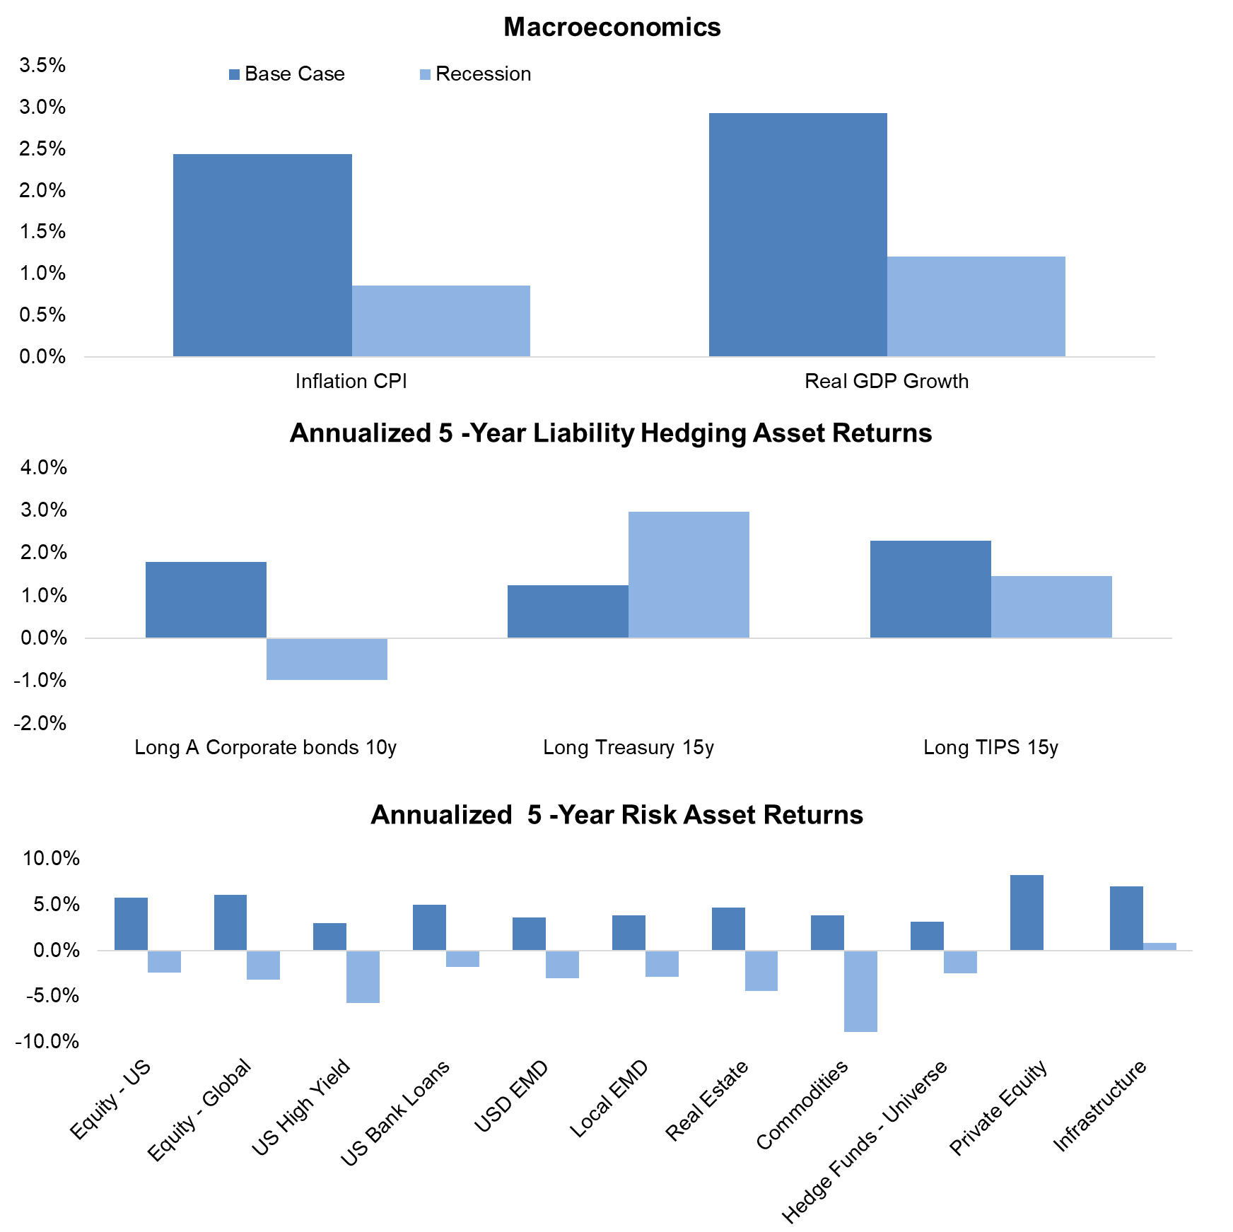
Recession Scenario
Description
The US economy slips back into recession in 2021
A resurgence of covid-19 infections driven by new variants and low vaccine take up necessitates further lockdown measures, as existing vaccines prove less effective and it takes time to develop, test and distribute updated vaccines.
The global economy experiences a deeper recession than the base case, as containment measures weigh heavily on economic activity.
The US experiences a deep recession in late 2021 and into 2022.
Inflation turns slightly negative in 2021 and early 2022. However, the period of deflation is short lived and inflation starts to rise in later years as an economic recovery begins to establish itself.
Treasury yields fall while TIPS yields remain at low levels as the US enters recession. Yields rise in later years as a recovery gets underway. Corporate spreads rise significantly due to the poor economic situation and increased risks of downgrades or defaults.
Most risk assets make losses in the first two years but rebound in later years as the economy recovers.
Returns from 30 June 2021
Source: Aon
The opinions referenced are as of the date of publication and are subject to change due to changes in the market or economic conditions and may not necessarily come to pass. Information contained herein is for informational purposes only and should not be considered investment advice.

Slide 87
Recession Scenario
Data Table
RECESSION SCENARIO
 | Year
 | 0 | 1 | 2 | 3 | 4 | 5 | 6 | 7 | 8 | 9 | 10
Yields (BOY)
Treasury yield 5y | 1.0% | 1.6% | 2.2% | 2.6% | 2.9% | 2.9% | 2.9% | 2.9% | 2.9% | 2.8% | 2.8%
Long Treasury yield 15y | 1.9% | 2.3% | 2.7% | 2.9% | 3.1% | 3.1% | 3.1% | 3.1% | 3.0% | 3.0% | 2.9%
TIPS yield 5y | -1.6% | -1.4% | -1.3% | -1.2% | -1.0% | -1.0% | -0.9% | -0.8% | -0.7% | -0.6% | -0.5%
Long TIPS yield 15y | -0.5% | -0.4% | -0.3% | -0.3% | -0.3% | -0.2% | -0.2% | -0.1% | -0.1% | 0.0% | 0.1%
Breakeven price inflation 15y | 2.4% | 2.7% | 3.0% | 3.2% | 3.4% | 3.4% | 3.3% | 3.2% | 3.1% | 3.0% | 2.9%
A Corporate bond yield 5y | 1.5% | 2.1% | 2.6% | 3.0% | 3.3% | 3.4% | 3.4% | 3.4% | 3.4% | 3.3% | 3.3%
Long A Corporate bond yield 10y | 2.4% | 2.9% | 3.3% | 3.6% | 3.8% | 3.8% | 3.8% | 3.8% | 3.8% | 3.8% | 3.8%
A Corporate spread 5y | 0.5% | 0.5% | 0.4% | 0.4% | 0.4% | 0.4% | 0.5% | 0.5% | 0.5% | 0.5% | 0.6%
Long A Corporate spread 10y | 0.8% | 0.8% | 0.8% | 0.8% | 0.8% | 0.8% | 0.8% | 0.8% | 0.9% | 0.9% | 0.9%
Expected nominal return on assets
Equity - US |  | -18.7% | -10.6% | 10.1% | 5.1% | 5.1% | 5.2% | 5.3% | 5.3% | 5.4% | 5.4%
Equity - Global |  | -21.4% | -12.2% | 10.9% | 5.4% | 5.4% | 5.4% | 5.5% | 5.6% | 5.6% | 5.7%
A Corporate bonds 5y |  | -6.2% | -0.4% | 4.0% | 4.8% | 3.6% | 3.9% | 4.0% | 4.0% | 3.9% | 3.9%
Long A Corporate bonds 10y |  | -7.9% | -3.7% | 0.4% | 4.5% | 2.2% | 2.3% | 2.6% | 2.8% | 3.0% | 3.1%
Treasury 5y |  | 6.1% | 0.1% | -1.3% | -0.6% | -0.2% | 0.9% | 1.0% | 1.1% | 1.2% | 1.2%
Long Treasury 15y |  | 26.1% | 1.7% | -6.8% | -1.5% | -1.6% | -0.2% | 0.1% | 0.2% | 0.4% | 0.5%
Long Treasury 30y |  | 51.6% | 2.1% | -6.2% | -3.3% | -4.0% | -2.1% | -2.0% | -1.5% | -1.6% | -1.3%
TIPS 5y |  | 2.1% | -0.4% | -1.0% | -1.1% | -0.9% | -0.3% | -0.2% | 0.0% | 0.1% | 0.2%
Long TIPS 15y |  | 15.6% | 1.0% | -4.0% | -1.9% | -2.2% | -0.8% | -0.7% | -0.5% | -0.4% | -0.3%
US High Yield |  | -8.8% | -21.1% | -6.1% | 6.9% | 2.9% | 3.1% | 3.3% | 3.5% | 3.6% | 3.8%
Bank Loans |  | -3.1% | -11.5% | -1.5% | 4.9% | 3.4% | 3.2% | 3.6% | 4.0% | 4.3% | 4.5%
USD Emerging Market Debt |  | -17.3% | -10.1% | 7.2% | 3.8% | 3.5% | 3.8% | 3.9% | 4.0% | 4.1% | 4.1%
Local Emerging Market Debt |  | -17.1% | -9.9% | 7.4% | 3.9% | 3.7% | 4.0% | 4.1% | 4.2% | 4.2% | 4.3%
Real Estate |  | -13.5% | -8.4% | -3.3% | 0.2% | 4.1% | 4.1% | 4.2% | 4.3% | 4.3% | 4.4%
Commodities |  | -28.4% | -22.5% | 6.5% | 3.1% | 3.1% | 3.2% | 3.2% | 3.3% | 3.4% | 3.5%
Hedge Funds - FoHF - Universe |  | -14.8% | -9.6% | 6.0% | 4.8% | 3.0% | 3.1% | 3.1% | 3.1% | 3.1% | 3.1%
Private Equity |  | -19.0% | -6.5% | 13.0% | 8.2% | 8.4% | 8.4% | 8.4% | 8.3% | 8.3% | 8.3%
Infrastructure - US |  | -5.7% | -1.3% | 2.1% | 2.9% | 6.5% | 6.6% | 6.6% | 6.7% | 6.7% | 6.8%
Cash |  | 0.0% | -0.8% | -0.6% | -0.3% | 0.0% | 0.2% | 0.5% | 0.7% | 0.9% | 1.0%
CPI |  | 0.6% | 0.7% | 0.8% | 1.0% | 1.2% | 1.3% | 1.4% | 1.5% | 1.6% | 1.7%
Scenario information as of June 30, 2021

Slide 88
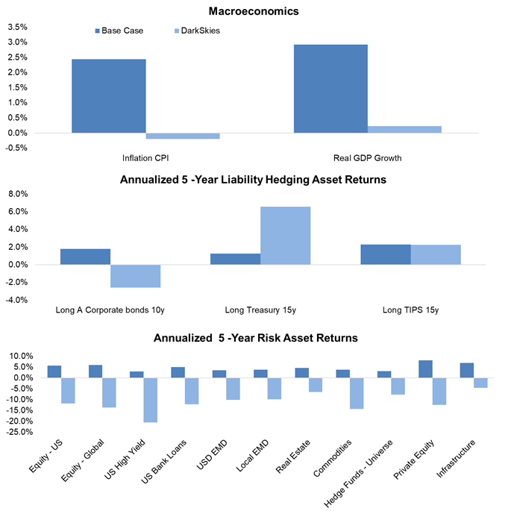
Dark Skies Scenario
Description
A deep recession followed by a longer period of stagnant growth
New mutations of covid-19 lead to seasonal waves of infections, which necessitates ongoing containment measures, hampering economic activity.
Economic weakness in developed and emerging market economies and severe levels of financial distress (due to high debt levels and political crisis) lead to a global recession followed by stagnation.
The US experiences a protracted deep recession.
Inflation is pushed into negative territory in 2021 and remains there in 2022, while continued sluggish growth over the following years means that inflation stays close to zero.
Treasury yields fall and remain at low levels as the US enters recession. Corporate spreads rise significantly due to the poor economic situation and increased risks of downgrades or defaults.
Risk assets make losses in the first few years. There is no pronounced bounce in growth and the economic situation remains poor for a long time, which weighs on returns in later years.
Returns from 30 June 2021
Source: Aon
The opinions referenced are as of the date of publication and are subject to change due to changes in the market or economic conditions and may not necessarily come to pass. Information contained herein is for informational purposes only and should not be considered investment advice.

Slide 89
Dark Skies Scenario
Data Table
DARK SKIES SCENARIO
 | Year
 | 0 | 1 | 2 | 3 | 4 | 5 | 6 | 7 | 8 | 9 | 10
Yields (BOY)
Treasury yield 5y | 1.0% | -0.5% | -1.0% | -1.0% | -0.9% | -0.8% | -0.5% | -0.3% | -0.1% | 0.2% | 0.4%
Long Treasury yield 15y | 1.9% | 0.0% | -0.4% | -0.5% | -0.4% | -0.3% | -0.1% | 0.1% | 0.3% | 0.5% | 0.7%
TIPS yield 5y | -1.6% | -2.3% | -2.7% | -2.8% | -2.7% | -2.6% | -2.4% | -2.3% | -2.1% | -1.9% | -1.7%
Long TIPS yield 15y | -0.5% | -1.9% | -2.2% | -2.2% | -2.2% | -2.1% | -1.9% | -1.7% | -1.6% | -1.4% | -1.2%
Breakeven price inflation 15y | 2.4% | 1.8% | 1.7% | 1.8% | 1.7% | 1.8% | 1.8% | 1.9% | 1.9% | 1.9% | 1.9%
A Corporate bond yield 5y | 1.5% | 4.8% | 5.0% | 4.7% | 4.1% | 3.8% | 3.8% | 3.7% | 3.6% | 3.5% | 3.4%
Long A Corporate bond yield 10y | 2.4% | 4.2% | 4.3% | 4.1% | 3.7% | 3.5% | 3.5% | 3.5% | 3.5% | 3.5% | 3.5%
A Corporate spread 5y | 0.5% | 5.4% | 6.0% | 5.7% | 5.1% | 4.6% | 4.3% | 4.0% | 3.7% | 3.3% | 3.0%
Long A Corporate spread 10y | 0.8% | 4.3% | 4.9% | 4.7% | 4.2% | 3.9% | 3.7% | 3.4% | 3.2% | 3.0% | 2.8%
Expected nominal return on assets
Equity - US |  | -27.7% | -20.1% | -11.2% | 2.2% | 2.2% | 2.5% | 2.9% | 3.3% | 3.6% | 4.0%
Equity - Global |  | -31.4% | -22.8% | -12.8% | 2.1% | 2.1% | 2.5% | 2.9% | 3.3% | 3.7% | 4.1%
A Corporate bonds 5y |  | -10.4% | -0.2% | 1.5% | 2.6% | 1.3% | 0.5% | 0.8% | 1.0% | 1.2% | 1.5%
Long A Corporate bonds 10y |  | -13.8% | -2.5% | 0.9% | 2.7% | 0.7% | -0.7% | -0.3% | 0.0% | 0.3% | 0.7%
Treasury 5y |  | 7.5% | 1.4% | -1.0% | -1.4% | -1.6% | -1.9% | -1.6% | -1.4% | -1.1% | -0.9%
Long Treasury 15y |  | 34.1% | 5.5% | 0.3% | -1.1% | -2.0% | -3.3% | -3.0% | -2.7% | -2.4% | -2.2%
Long Treasury 30y |  | 73.0% | 5.0% | 0.6% | 1.5% | -2.9% | -3.9% | -3.8% | -3.5% | -3.5% | -3.3%
TIPS 5y |  | 1.2% | -1.4% | -1.7% | -2.5% | -2.6% | -2.4% | -2.1% | -1.8% | -1.5% | -1.3%
Long TIPS 15y |  | 19.2% | 1.0% | -1.2% | -2.9% | -3.3% | -3.9% | -3.6% | -3.3% | -3.0% | -2.7%
US High Yield |  | -14.4% | -37.4% | -27.9% | -14.9% | -3.4% | -4.1% | -3.3% | -2.6% | -1.8% | -1.0%
Bank Loans |  | -6.0% | -24.8% | -18.0% | -8.7% | -0.8% | -0.7% | 0.0% | 0.7% | 1.4% | 2.0%
USD Emerging Market Debt |  | -23.8% | -15.7% | -9.2% | 0.8% | 0.3% | 0.2% | 0.6% | 1.0% | 1.4% | 1.8%
Local Emerging Market Debt |  | -23.6% | -15.5% | -9.0% | 0.9% | 0.5% | 0.4% | 0.8% | 1.2% | 1.6% | 2.0%
Real Estate |  | -15.2% | -10.8% | -5.2% | -0.9% | 1.2% | 1.6% | 1.9% | 2.3% | 2.6% | 3.0%
Commodities |  | -35.5% | -27.5% | -4.0% | 1.7% | 1.7% | 1.9% | 2.1% | 2.3% | 2.6% | 2.8%
Hedge Funds - FoHF - Universe |  | -17.7% | -12.5% | -6.9% | 0.1% | 0.1% | 0.4% | 0.7% | 1.0% | 1.3% | 1.6%
Private Equity |  | -30.9% | -22.4% | -11.7% | 4.2% | 4.2% | 4.6% | 5.0% | 5.4% | 5.8% | 6.2%
Infrastructure - US |  | -12.5% | -8.3% | -4.5% | 0.5% | 3.1% | 3.5% | 3.9% | 4.3% | 4.7% | 5.1%
Cash |  | 0.0% | -1.0% | -1.1% | -1.0% | -1.0% | -0.8% | -0.5% | -0.2% | 0.0% | 0.2%
CPI |  | -0.9% | -1.0% | 0.2% | 0.3% | 0.4% | 0.6% | 0.7% | 0.9% | 1.1% | 1.3%
Scenario information as of June 30, 2021

Slide 90
Appendix
How Do Public Pensions Impact Credit Ratings?

Slide 91
How Do Public Pensions Impact Credit Ratings?
Summary and Conclusions
Pension Impact on Credit Ratings
  Pension plans have a direct impact on the ultimate state or local credit rating
  Rating agencies are not just looking at where public pension plans stand today; they are looking at the expected future trajectory of the plan based on how it is managed
Credit Ratings and Borrowing Costs
  Taxpayers in lower credit rated jurisdictions are paying higher borrowing costs and could save money through healthier pension plan management
Call to Action
  The Big Three (Fitch, Moody’s and S&P) value selecting appropriate actuarial assumptions, avoiding excessive risk taking, and developing an adequate funding policy
  While debt priorities and revenue framework to service such debt will vary on a case-by-case basis, every jurisdiction has the ability to thoughtfully develop a funding policy and set appropriate assumptions
  These initial steps will help pension stakeholders better understand the true economic costs, improve the funding outlook for public pensions, and potentially reduce borrowing costs and further taxpayer burden

Slide 92



How Do Public Pensions Impact Credit Ratings?
Call to Action: Plan Sponsors Have Ability to Impact Credit Rating
Below are three specific actions plan sponsors can take today to directly improve the impact a pension plan will have on the credit rating of its locality:
Action |  | Considerations
 | 1. Conduct an actuarial assumption audit Review reasonability of key assumptions: Salary scale, Mortality, Retirement rates, Turnover rates | Assumptions set to plan-specific expectations will lead to lower contribution volatility Aggressive assumptions may provide short-term relief but may have long-term consequences
 | 2. Consider adjustments to expected return assumption Adjustments should be in line with forward-looking expectations for asset returns | Contributing an actuarial amount? Yes: Failing to achieve target returns will necessitate increases in future contributions and make what was intended to be a smooth, budget-friendly progression of contribution increases far more volatile No: The funding gap will widen and become highly volatile as contribution policy will not add enough dollars to replenish losses
 | 3. Review the plan’s funding policy Look far enough into the future to identify potential pain points | Conduct “tread water”/hurdle rate analysis to ensure short-term contributions are sufficient to keep pace with growth of plan liabilities Consider asset-liability study to understand range of potential future outcomes rather than a single deterministic scenario

Slide 93
Appendix
Asset-Liability Management Background

Slide 94
Asset-Liability Management Background
What is an Asset-Liability Study?
What?
Why?
When?
How?
A comprehensive toolkit for making decisions on a fund’s asset allocation and investment risk that align with the liabilities those funds support
  Aon believes optimal decisions regarding pension plan management are made when they are based on a clear understanding of the assets and liabilities of the plan(s) and how they interact
For a formal review of the asset-liability modeling, Aon suggests conducting asset-liability studies every 3 to 5 years depending on client specifics, or more frequently should circumstances dictate (e.g., material changes to the liability profile, etc.)
Identify future trends in the financial health of the fund (e.g., funded ratio, contributions, etc.) based on economic uncertainties that may not be evident from an actuarial valuation, which provides only a snapshot at a point in time

Slide 95
Asset-Liability Management Background
Balance of Liabilities and Assets
RETIREMENT PLAN
+ Cash Contributions
+ Asset
Return
+ New Benefit Accrual
+ Liability Return
Assets
$
Liabilities
$
- Benefit Payments
- Benefit Payments

Slide 96
Asset-Liability Management Background
Overview of the Asset-Liability Study Process
Planning Discussions
Asset-Liability Projections
Planning
Objectives of the study
Modeling and liability assumptions
Risk tolerance
Risk preference
Demographics
Funded status
Business/financial
Industry practices
Asset Modeling
Capital market analysis
Efficient frontier analysis
Portfolios for study
Liability analysis
Cost Projections
Funded status
Sensitivity analysis
+
+
+
Desired Outcomes:
Understand the pension risk
Identify optimal investment strategy
Implementation
Monitoring & Execution

Slide 97
Asset-Liability Management Background
Modeling Process
Goals of an asset-liability study:
  Understand the pension plan’s asset-liability risk, and
  Identify the optimal investment strategies
Stochastic, Monte Carlo simulation analysis used
  5,000 independent economic trials
  Building block approach
    Starts with inflation and interest rates
    Using a multi-factor regression analysis, other asset classes are then modeled
  Assets and liabilities are modeled over the projection period
    Projections include contribution requirements and funded ratios
Asset-liability studies are best-suited to determine the optimal mix of return-seeking (e.g., equity) and fixed income assets for the pension fund
  Asset mix is the single most important investment decision for the plan sponsor
    Is it worthwhile to have a more aggressive allocation in order to reduce long-term cost in exchange for risk of higher costs in a bad outcome?
    Is it worthwhile to have a more conservative allocation in order to have a more predictable cost in exchange for potentially higher average costs?

Slide 98
Asset-Liability Management Background
Mechanics of Asset-Liability Modeling Process
Asset and liability modeling integrated in single platform Integrates impact of key economic variables
Flexibility in modeling parameters and output to client preferences
Stochastic and deterministic modeling performed
Asset Mix
Demographics
Plan Design
Actuarial Assumptions
Inflation
Interest
Rate
Duration
Discount Rate
Correlation
Portfolio
Return
Salary
Increase
Liabilities
Contributions
Funded Ratio

Slide 99
Asset-Liability Management Background
Long-Term Economic Cost of Plan
Long-Term Economic Cost =
Present value of plan contributions +
Present value of terminal funding, adjusted by a utility factor
Present Value of Plan Contributions
  Main component of long-term economic cost
  Does not reflect the plan’s funded status at the end of the forecast period
Present Value of Terminal Funding
Terminal Funding | Surplus | Shortfall
Utility Rationale | Declining value, or utility, from very high funded ratios | Increasing “pain” as unfunded amounts grow to high levels
Threshold | PVB / AL | (5 Yrs. of Benefit Payments) / AL
Utility Factor above/below threshold | 50% | 200%
Utility Factor Applied to Terminal Funding
  Reflects the plan’s funded status at the end of the forecast period
  Surplus assets are valuable as they lower future contributions
  Unfunded liabilities are costs that will be recognized in future years

Slide 100
Asset-Liability Management Background
Utility Factor For Terminal Funded Status
Modest deviations from 100% funding are normal, and no special adjustment is needed for these scenarios – the amount of surplus or unfunded liability can be reflected at its dollar value
As surplus amounts grow to very high levels, there is a declining value, or utility, to the surplus:
  Contributions cannot go below zero
  Long contribution holidays may create a false sense of how much the plan really costs, and lead to confusion when cost levels revert to “normal”
  Large surplus amounts can become a potential target for non-pension applications
As unfunded amounts grow to very high levels, there is an increasing amount of “pain” as contributions rise to unacceptable levels:
  May be viewed as “breaking trust” with future taxpayers
  Freezing of the pension plan becomes a possibility
Notes:
100

Slide 101
Asset-Liability Management Background
Risk and Return in an Asset-Liability Context
Traditional:
  Return = Investment performance
  Risk = Annual volatility of investment gains and losses
  (e.g. weak/negative capital market returns)
Asset-Liability:
  Return = Potential cost reduction or funded status improvement under average economic
  conditions
  Risk = During the worst economic conditions, contributions need to increase or funded status
  declines (e.g., stocks decline, inflation/deflation shocks and/or interest rates decline)

Slide 102
Asset-Liability Management Background
Key Factors Affecting the Risk/Reward Trade-off
The key take-away from the asset-liability study is the allocation between equity (“return-seeking”) vs. fixed income (“risk-reducing”)
Major factors affecting the ultimate mix are:
  Time horizon (or amortization period of unfunded liability) to fund the liability
    a longer time horizon supports more risk taking
  Characteristics of plan participants
    a growing population of active participants supports more risk taking; a mature population with significant retirees might need a more conservative policy
  Funded status
    a less funded plan can utilize additional returns from equity investments
  Nature of plan benefits
    a pension with sensitivity to wage inflation growth can benefit from equities in the long-term; an increased need in liquidity due to significant benefit payments in the near future can have a more conservative policy

Slide 103
Asset-Liability Management Background
Limitations of Asset-Liability Modeling
Asset-liability studies are best-suited to determine the optimal mix of return-seeking (e.g., equity) and risk-reducing (e.g., fixed income) assets for the retirement fund
  Asset mix is the single most important investment decision for the plan sponsor
  Studies have found that more than 90% of the variability of a portfolio’s return is determined by the asset allocation
  Decisions regarding how to divide allocations among various sub-categories are less important in an asset-liability context and can be addressed in the implementation phase, following the asset-liability study
Asset-liability modeling can capture the likelihood of a strategy meeting the objectives
  It does not ‘predict’ the future, i.e., we cannot say which of the economic scenarios will actually occur
  The results depend on the assumptions underlying the model and the structure of the model itself
There are elements that cannot be modeled and must be thought of in addition to the results of any analysis:
  E.g., idiosyncratic manager risk, liquidity requirements
  Black swans

Slide 104
Asset-Liability Management Background
Glossary of Terms
  AVA – actuarial value of assets (i.e., incorporates smoothing of gains and losses)
  Asset Growth Rate or “Hurdle Rate” – The required rate of growth of the assets (through both contributions and investment returns) to keep pace with the growth of the liability
  Current Frontier – uses SBA’s mix of asset classes within the return-seeking allocation, then dials the return-seeking allocation up and down from 0% to 100% to illustrate forecasted returns at various return-seeking / safety asset mixes
  Economic Cost – present value of forecasted future contributions + present value of funding shortfall / (surplus) at the end of the projection period
  Liability Growth Rate – the projected growth of the liability over the coming year as measured by the sum of the normal cost (new benefit accruals) and interest cost (one less year of discounting at the time value of money)
  MVA – market value of assets (i.e., un-smoothed / economic reality)
  Return-Seeking Assets (“R-S”) – all non “safety” assets
  Safety Assets – assets where the primary function is risk control / downside mitigation.
  Target Asset Allocation – the allocation of assets between return-seeking assets and
  safety assets

Slide 105
Appendix
About This Material

Slide 106
Meeting of the Investment Advisory Council
Item 4. Global Equity Asset Class Review
Tim Taylor, Senior Investment Officer
(See Attachments 4A)

Slide 107
Global Equity
Meghan Brown, Senior Portfolio Manager
Denise Hale, Director of Reporting & Analytics
Tim Taylor, Senior Investment Officer
Investment Advisory Council
September 20, 2021

Slide 108
Global Equity Presentation
Overview
  Global Equity Staff
  Investment Policy Defines Objectives
  Market and Industry Dynamics
  Work Plan and Looking Forward
Global Equity By the Numbers
  Top-Down Look: Global Equity’s Role in the Total FRS
  Delivering on Objectives & Historical Characteristics
  Structure Details
Performance Review
  Aggregate Returns
  Performance of Active Aggregates

Slide 109
Overview

Slide 110
Experienced Staff with Complementary Skills
Senior Investment Officer
Tim Taylor
Internal Management and Trading
Samantha Kane
Jennifer Myers
Brian Staverosky
James Wells
Joe Wnuk
External Manager Oversight
Meghan Brown
Daniel Gold
Dustin Heintz
Jeff Smithson Luke Tucker
Administration
Lisa Cheshire
Whitney Kirk
Risk and Analytics
Lauren Cochran
Denise Hale
Ted Nation
Financial Operations
Accounting
General Counsel
Risk Management & Compliance
Corporate Governance
Information Technology

Slide 111
Global Equity Investment Policy Statement
Invest to achieve or exceed the return of the Benchmark over a long period of time
  Remain well-diversified relative to the Benchmark
  Maintain a reliance on low-cost passive strategies scaled according to:
    The degree of efficiency in underlying securities markets
    Capacity in effective active strategies
    Ongoing total fund liquidity requirements

Slide 112
Investment Policy Benchmark
SBA Custom MSCI All Country World Investable Market Index (MSCI ACWI IMI)
  Large-, mid- and small-capitalization stocks
  In US-dollar terms
  Reflects provisions of Protecting Florida’s Investments Act Legislation (PFIA)
  Includes over 50 countries and over 9,200 securities
Benchmark Regional Weights (%)
Benchmark Sector Weights (%)
Note: Source MSCI, FactSet. As of June 30, 2021.
Notes:
Updated

Slide 113
Investment Policy: Implementation Snapshot
Well Diversified vs. Benchmark
Invest to Achieve or Exceed Equity Benchmark
Total AUM: $108bn
10,000+ Securities
64 Countries
46 Currencies
7 Internal Strategies
58 Externally Managed Strategies
Focus on Return and Low Costs
Opportunistically Invest in Active Strategies
 | Market Value | Inception
Active Currency | $2,950M Notional | 2014
US Microcap | $405M | 2014
Schiehallion | $356M | 2019
Notes:
updated

Slide 114
Objectives Drive What We Do
What We Do
Pitfalls We Strive to Avoid
Provide Beta | Invest 49.8% of assets passively | Becoming an index fund
Manage Costs | Aggressively, and fairly, negotiate fees | Overpaying for non-unique alpha
Diversify Sources of Alpha | Implement/Fund strategies with varying philosophies, processes, geographic focus and sector exposures | Relying on a specific market condition or environment to drive relative performance
Maintain Low Active Risk | Focus on aggregate construction using multiple risk lenses to ensure diversification | Taking uncompensated or concentrated risk, or not identifying a notable risk
Be Selectively Opportunistic | Invest in Currency, US Microcap, China-A, Public/Private Fund and Internal Factor Strategies | Allowing scale to dampen opportunism
Provide Liquidity | Consistently raise funds with emphasis on enhancing risk/return profile and minimizing transaction costs | Sacrificing excess return potential by not funding or limiting less liquid strategies
Notes:
Passive # updated

Slide 115
Navigating 2020-2021's Dynamic Market Environment
Provide Beta | Strong and consistently rising equity markets are challenging for passive managers (cash drag), combined with continued pressure on historical sources of value-add (e.g. Sec Lending).
Manage Costs | Industry pressure on fees have cost benefits but create manager and industry risk, particularly when combined with poor active performance records. Advancements continued with respect to inexpensively capturing factor exposures expected to outperform.
Diversify Sources of Alpha | Growth outperformance vs. Value stalled at "re-opening" trade spurred by vaccine announcements, however reasserted itself on fears related to the COVID delta-variant and other factors. Low interest-rate environment, uncertainty over global economic growth, historical spreads of growth to value stocks and numerous other uncertainties warrant a diversified portfolio.
Maintain Low Active Risk | Market volatility surged early in 2020 and remained elevated from historically low levels.
Be Selectively Opportunistic | Increasing challenges to traditional active management. Benchmark concentration, growth of passive and ETF industry.
Provide Liquidity | Challenge of low liquidity persists in market segments with rich alpha potential.

Slide 116
Meeting Objectives By Navigating Dynamic Market Environments
Provide Beta | Pressure on passive value-add sources | Continued to develop internal passive management resources, focusing on staff development and efficient trading to minimize transaction costs.
Manage Costs | Fee pressure | Aggressively negotiated fees for newly funded strategies. Percentage of assets internally managed continued to rise, including active mandates targeting potential alpha-generating factors.
Diversify Sources of Alpha | Growth vs. Value Spread "Re-opening" Trade | New fundings included three International Small Cap, one Developed Standard, one Emerging Markets and one US Large Cap strategy. Modest reallocations/restructurings across aggregates.
Maintain Low Active Risk | Elevated market volatility | After adding to equities in the first-half of 2020 in response to a dramatic selloff, profits were realized and provided to other asset classes after surging markets prompted asset allocation rebalances. Risk managed within policy bounds as active returns remained relatively constant.
Be Selectively Opportunistic | Challenges to traditional active management | Exited dedicated Frontier Markets aggregate to focus resources on alternative, equity-related, non-traditional opportunistic strategies.
Provide Liquidity | Liquidity vs. Alpha tradeoff | Raised over $10 Billion in Fiscal Year 2021.
Recent Market Dynamics
Actions Taken in FY2021
Notes:
Liquidity # updated

Slide 117
Meeting Objectives: Looking Forward
Selected Elements of FY2022 Work Plan
Provide Beta | Continue to strive for best execution for internal passive and active strategies, and support staff development related to this important function.
Manage Costs | Further evaluate opportunities to manage strategies internally. Continue to negotiate and, as appropriate, renegotiate fees.
Diversify Sources of Alpha | Maintain focus on monitoring and periodically restructuring sub-aggregates as needed, and identifying and monitoring external managers with excellent potential.
Maintain Low Active Risk | Enhance analytics capabilities with efficient investment in human capital and systems.
Be Selectively Opportunistic | Continue efforts to identify and review opportunistic strategies that may improve the risk/return profile of the asset class.
Provide Liquidity | Use liquidity draws to rebalance / reposition the aggregate and address modest structural biases. Maintain significant exposure to liquid portfolios while selectively adding to less-liquid strategies.

Slide 118
Global Equity By The Numbers

Slide 119
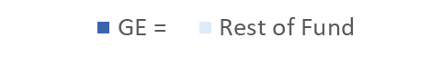
Top Down View: Global Equity’s Role in the Total Fund
% of Total FRS Assets
% Contribution to Total FRS 3-Yr Absolute Return
Policy Range:
45% - 75%, With 53% Target
Policy Goal:
Seek Absolute Returns
% of Total FRS Assets Internally Managed by GE
% Contribution to Total FRS 3-Year Excess Return
Policy Goal:
Reliance on Low Cost (Passive) Strategies
Policy Goal:
Exceed Returns of Benchmark
% of Liquidity Provided by GE in Last 3 Years
% Contribution to Total FRS Active Risk
Policy Goal:
Meet Ongoing Funding Requirements
Amount Raised in 3 Years:
$19bn
Policy Goal:
Passive with Active Risk in Less Efficient Markets

Slide 120
Delivering on Policy and Objectives
Provide Alpha and Beta: % Actively Managed
Maintain Low Active Risk: Tracking Error Over Time
Policy Range: 47% - 57% Active
Current Aggregate Beta: 0.99
Policy: 0.75% Monitoring Standard and 1.25% Escalation Standard
Take Risk Where Rewarded: Information Ratio
Low Active Risk: Take Tracking Error Where Rewarded
Policy Risk Adjusted Return Standard (3 Year): 0.30
Current 3 Year IR: 1.00
Range Predicted Tracking Error for Individual Strategies: 0.04% to 17.62%
Note: As of June 30, 2021.
Notes:
Updated

Slide 121
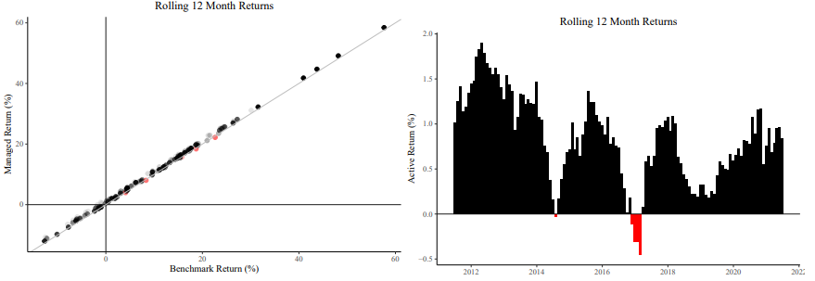
Structured for Performance Consistency
Global Equity Rolling One-Year Performance
Global Equity Outperformed Benchmark, net of fees, in 116 of 121 Rolling One-Year Periods
Notes:
Updated

Slide 122
Structured to Perform in a Variety of Market Conditions
Notes:
Updated

Slide 123
Diversify Sources of Alpha and Risk: Strategy Types
Diversified for Market Conditions
Defensive Active
Low Beta
High Yield
Earnings Stability
Core Active
Multifactor Quant
Quality Emphasis
Regional Strategies
Upmarket Active
High Growth
Pro - Cyclical
Currency Overlay
Passive
Diversified by Investment Process
 | Fundamental Approach |  |  | Traditional Quantitative Approach |  |  | Factor/Other
 | Growth | Core | Value | Growth | Core | Value
US LC |  | ☑ |  |  | ☑
US Small Cap | ☑ | ☑ | ☑ | ☑ | ☑ | ☑ | ☑
Developed LC | ☑ | ☑ | ☑ |  | ☑ |  | ☑
Developed SC | ☑ | ☑ | ☑ |  | ☑ |  | ☑
Emerging | ☑ | ☑ | ☑ |  | ☑ |  | ☑
Global | ☑ | ☑ | ☑ |  | ☑ |  | ☑
Currency |  | ☑ |  |  | ☑ |  | ☑

Slide 124
Diversify Alpha: Active Management Structure
Higher Active Exposures In Segments Where Risk Is Rewarded
 | Total AUM ($mm) | % Active | Average Active Mandate Size ($mm) | # of Active Strategies
US LC | $50,823 | 4.4% | $753 | 3
Developed LC | $21,937 | 90.0% | $1,975 | 10
Emerging | $12,586 | 100.0% | $839 | 15
Global | $12,323 | 74.8% | $1,844 | 5
Developed SC | $4,820 | 100.0% | $536 | 9
US SC | $3,720 | 70.7% | $239 | 11
Currency | $2,950 (Notional) | 100.0% | $983 | 3
Notes:
Updated

Slide 125
Performance Review

Slide 126
Performance: Total Global Equity
 | 2Q 21 | CYTD | 1 Yr | 3 Yr | 5 Yr | Incept Jul 2010
GE Return | 7.50 | 13.24 | 41.78 | 14.94 | 15.17 | 12.48
Benchmark | 7.16 | 12.66 | 40.95 | 14.27 | 14.57 | 11.65
Excess Return | 0.34 | 0.58 | 0.83 | 0.67 | 0.60 | 0.83
Tracking Error |  |  | 0.92 | 0.56 | 0.50 | 0.52
Info Ratio |  |  | 0.59 | 1.00 | 1.00 | 1.39
Notes:
Updated

Slide 127
Performance: Returns by Approach and Region
Notes:
Updated

Slide 128
Performance: By Active Aggregate
Key Drivers of One Year Returns
Foreign Developed Standard
  A successful year with notable contributions from value-oriented managers who have faced a difficult environment for a very long time. Contributions also came from disruptive growth stocks that benefited greatly during a pandemic that prompted dramatic changes to our everyday lives.
Emerging Markets
  An underweight to China proved positive as investor sentiment soured due to an increased level of regulatory activity in certain sectors such as Information Technology.
Dedicated Global
  The aggregate was penalized by its defensive, low-beta characteristics in a period that the market raced ahead.
Foreign Developed Small Cap
  The aggregate benefited at various times from growth, momentum and value-oriented factors as leadership varied widely during the period.
Currency
  Positions in Emerging Markets and Cyclical currencies outperformed the US dollar, reversing the pattern of performance that took place as the pandemic took hold in 2020.
US Small Cap
  Underweights to the defensive Utilities, Real Estate and Healthcare sectors boosted outperformance in a highly speculative market.
US Large Cap
  This aggregate outperformed in Q2 2021, the first full period since it was repositioned and style benchmarks were eliminated. Full-year alpha was boosted as market leadership finally shifted away from a handful of mega-cap, growth stocks.
Notes:
Returns updated

Slide 129
Appendix

Slide 130
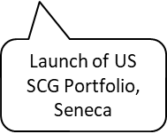
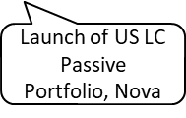
Process: Internal Asset Management
% Internally Managed Assets over Time
Launch of Global Passive Portfolio, Atlas
Launch of Internal Global Factor Strategy, Sinensis
Benefits of GE’s Internal Management Program
Explicit cost advantage in that asset management fees are not paid to external investment firms
Fixed cost of running passive money spread over large asset base
Ability to leverage skills gained in directly managing money to analyze external managers
Capability to internally manage equity transitions and liquidity raises
Opportunity to support trading needs of other asset classes
Ability to manage cash flows associated with Currency program
Notes:
updated

Slide 131
Meeting of the Investment Advisory Council
Item 4. Global Equity Asset Class Review
Jay Love, Mercer
(See Attachments 4B)

Slide 132
Florida State Board of Administration
Review of Public Equity Markets
September 2021
Not Peer Reviewed

Slide 133
Agenda
SBA’s Public Markets Investment Program
Review of Equities
Recent Activity

Slide 134
SBA’s Public Markets Investment Program

Slide 135
SBA’s Public Markets Investment Programs
Guiding Principles
All asset classes shall be invested to achieve or exceed the return of their respective benchmarks over a long period of time. To obtain appropriate compensation for associated performance risks:
  Public market asset classes shall be well diversified with respect to their benchmarks and have a reliance on low cost passive strategies scaled according to the degree of efficiency in underlying securities markets, capacity in effective active strategies, and ongoing total fund liquidity requirements (Investment Policy Statement).

Slide 136
SBA’s Global Equity Investment Program
Mercer’s General Observations
FRS is very intensive in its manager due diligence, selection and monitoring
The global equity asset class is managed in a prudent, risk-controlled fashion.
Appropriate levels of delegation are given to the staff
FRS is a significant user of passive management albeit slightly less than peers (48% of Portfolio vs. 52% of peers¹)
Active risk levels are monitored against predetermined ranges
The Plan effectively uses internal resources to keep costs low (46% of Portfolio vs. 40% of peers¹)
Results have been favorable over all time periods measured
¹ Source: Data as of 12/31/2019 – CEM 2020 Survey
Notes:
Update statistics to just be global equity -

Slide 137
Review of Equities
Asset Allocation – Passive versus Active
The SBA uses more internal passive management and external active management relative to peers.
 | FRS¹ | Peers
Internal Passive | 44.5% | 26.3%
Internal Active | 1.3% | 13.6%
External Passive | 3.9% | 25.9%
External Active | 50.3% | 34.3%
¹ May not add to 100% due to rounding.
Source: Data as of 12/31/2019 – CEM 2020 Survey

Slide 138
SBA’s Public Markets Investment Programs
Guiding Principles
In 2016, Mercer conducted a structural review of the Global Equity Asset Class and concluded Global Equity incorporates many of the best practices in institutional fund management and is appropriate given the FRS’s size and negative cash flow position. Specifically, Mercer believes there are a number of key areas that should be evaluated for best practices, with some key observations for SBA:
  Active/Passive Allocations. The SBA is utilizing active/passive management across sub-asset classes effectively.
  Use of Internal Management. The SBA has been cost effective in their use of internal passive management within the US Equities and Dedicated Global Equities space, unlike many of their peers.
  Active Risk Budget. The risk budgeting monitoring standards for the FRS Pension Plan for the Global Equity asset class is a monitoring standard of 0.75% and an escalation standard of 1.25% and staff has stayed well within these bounds over time.
  Investment Manager Review. Overall we believe the sub-asset classes to be well diversified in terms of manager style and risk.
  Benchmarking/Market-Capitalization Weighted Exposures. Except in unique circumstances, the staff has incurred very little misfit risk relative to its asset class benchmarks.
  Potential Alpha Opportunities. The Global Equity staff continually researches and capitalizes on potential alpha opportunities which has included exposures to China A shares, frontier markets, emerging markets small cap, US microcap, and a currency overlay program.
  Performance Summary. The SBA has realized strong risk-adjusted returns historically. These strong risk-adjusted returns are attributable to the SBA’s thoughtful approach to portfolio construction through employing passive mandates in more efficient markets, allocating assets to a diversified yet high conviction active manager base, and deploying assets in higher alpha potential market segments.
Notes:
Priority list? Global and smart beta

Slide 139
Review of Equities

Slide 140
Review of Equities
Asset Allocation – Region
In July 2010 the SBA consolidated its separate allocations to US and Foreign Equity asset classes into a single Global Equity asset class benchmarked to the FSB ACWI IMI ex Iran and Sudan.
Compared to peers, the SBA has a smaller allocation dedicated global equity.
Product¹ | FRS | Large Plan Peers | US Public Plans | MSCI ACWI IMI
US Equity | 49.9% | 42.5% | 46.8% | 55%
Developed Market ex US | 30.4% | 23.8% | 29.0% | 33%
Emerging Markets | 11.2% | 7.4% | 7.4% | 12%
Global Equity² | 8.3% | 25.4% | 14.0% | -
Other | 0.0% | 0.9% | 2.7% | 0.0%
¹ May not add to 100% due to rounding
² The lower allocation to global equities is due to a greater use of dedicated strategies.
Source: Data as of 12/31/2019 – CEM 2020 Survey

Slide 141
Review of Equities
Asset Allocation – Passive versus Active
On an absolute basis, the SBA uses passive management for most of its US allocation and active management for most Non-US Equity. The majority of dedicated Global Equity mandates are fully active and all Emerging Market mandates are fully active.
Compared to peers, the SBA uses more passive management for its US Equity allocation and more active management for its Non-US Equity allocation.
Product | FRS | Peers¹
US Equity
Passive | 84.6% | 71.6%
Active | 15.4% | 28.4%
Developed Market ex US
Passive | 12.7% | 24.3%
Active | 87.3% | 75.8%
Emerging Markets
Passive | 0.0% | 18.4%
Active | 100.0% | 81.6%
Global Equity
Passive | 28.4% | 56.0%
Active | 71.6% | 44.0%
¹ May not add to 100% due to rounding
Source: Data as of 12/31/2019 – CEM 2020 Survey
Notes:
15.5% = active US equity.

Slide 142
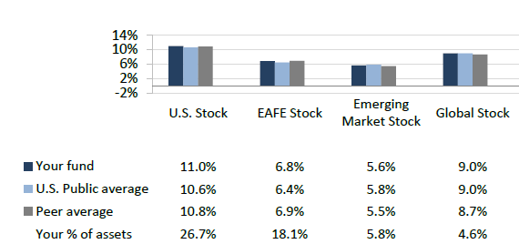
Review of Equities
Performance: Global Equity versus Peers
Relative to peers, the SBA outperformed in domestic, global, and emerging markets equity, but modestly lagged within international equity.
Source: Data as of 12/31/2019 – CEM 2020 Survey

Slide 143
Review of Equities
Fees: Global Equity versus Peers
Relative to peers, FRS fees are cheaper in all sub-asset classes, except in external passive management for Developed Market ex-US.
Product | FRS | Median Peer
US Equity
External Active | 26.1 | 36.6
External Passive | n/a | 1.0
Developed Market ex US
External Active | 25.1 | 39.1
External Passive | 3.0 | 2.9
Emerging Markets
External Active | 47.5 | 56.2
External Passive | n/a | 11.9
Global Equity
External Active | 41.9 | 41.9
External Passive | n/a | n/a
Fees in basis points
Source: Data as of 12/31/2019 – CEM 2020 Survey

Slide 144
Review of Equities
Performance: US, Non-US, & Dedicated Global Equity
Over the 3- and 5-year periods, the FRS US Equity allocation has delivered negative risk-adjusted returns (negative information ratio). However, performance relative to peers ranks favorably over both periods. Over the 5-year time period, the information ratio ranked just below the peer group median.
Over the 3- and 5-year period, the FRS Non-US Equity portfolio has delivered strong risk-adjusted returns with an information ratio ranking in the top decile among its peer group universe over both periods.
Over the 3- and 5-year period, the FRS Dedicated Global Equity allocation has delivered negative risk-adjusted returns (negative information ratio). Additionally, over both periods, the information ratio ranked in the bottom half among peers.
Periods Ending 6/30/2021 | Year to Date Return (Rank) | 1 Year Return (Rank) | 3 Years Return (Rank) | 5 Years Return (Rank) | Inception (April 1988) Return (Rank)
FRS US Equity ^{1, 2} | 15.54% (45) | 44.46% (53) | 18.34% (25) | 17.72% (31) | 11.26%
Benchmark | 15.11% | 44.16% | 18.73% | 17.89% | 11.21%
Value Added | 0.43% | 0.30% | -0.40% | -0.17% | 0.05%
Information Ratio³ | -- | -- | -0.93 | -0.46 | --
Tracking Error³ | -- | -- | 0.33% | 0.28% | --
 |  |  |  |  | Inception (October 1992) Return (Rank)
FRS Non-US Equity ^{2, 4} | 10.25% (46) | 40.10% (27) | 11.32% (42) | 12.66% (39) | 7.86%
Benchmark | 9.52% | 37.20% | 9.46% | 11.23% | 6.75%
Value Added | 0.73% | 2.90% | 1.86% | 1.43% | 1.11%
Information Ratio³ | -- | -- | 1.25 | 1.09 | --
Tracking Error³ | -- | -- | 1.35% | 1.19% | --
 |  |  |  |  | Inception (June 2003) Return (Rank)
FRS Dedicated Global Equity ^{2, 5} | 12.74% (52) | 35.61% (90) | 13.62% (46) | 13.52% (51) | 9.12% (82)
Benchmark | 12.80% | 38.91% | 14.90% | 14.81% | 9.80%
Value Added | -0.06% | -3.30% | -1.28% | -1.29% | -0.68%
Information Ratio³ | -- | -- | -0.62 | -0.70 | --
Tracking Error³ | -- | -- | 2.23% | 1.86% | --
¹ Compared to the Public Funds >$1B – US Equity universe; rankings are based on gross-of-fees FRS performance.
² Returns are shown net of fees.
³ Calculated using monthly returns
⁴ Compared to the Public Funds >$1B – Non-US Equity universe; rankings are based on gross-of-fees FRS performance.
⁵ Compared to the Public Funds >$1B – Global Equity universe; rankings are based on gross-of-fees FRS performance

Slide 145
Recent Activity

Slide 146
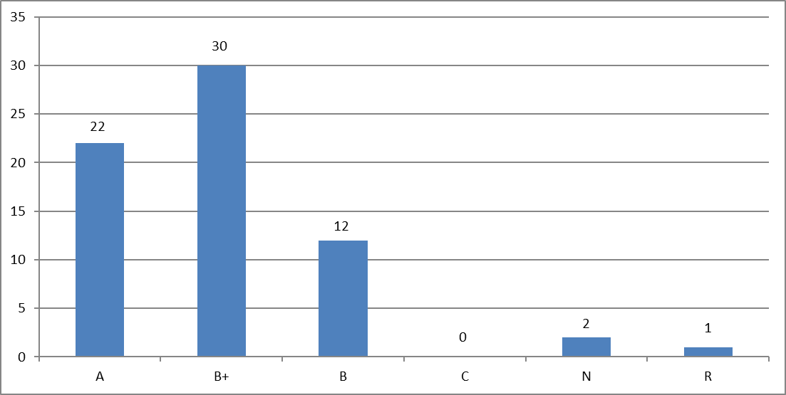
Mercer Research Rating Review
Breakdown of Strategies by Rating
Of the 67 external global equity strategies in the Plan, 52 strategies, or 78%, are rated “B+” and above.
The graph below shows the breakdown of the strategies by the Mercer Rating:
Mercer Ratings:
  A = "above average" prospects of outperformance
  B+ = "above average" prospects of outperformance, but there are strategies in which Mercer has greater conviction
  B = "average" prospects of outperformance
  C = "below average" prospects of outperformance
  N = not rated
  R = Mercer does not maintain formal ratings in category, but has reviewed the strategy.

Slide 147
Recent Activity
Emerging Markets Small Cap Equity Search
US Small Cap Equity Search
Regularly working with staff conducting ongoing performance and manager monitoring
Increased focus on operational due diligence
Ongoing manager reviews
Notes:
147

Slide 148
Services provided by Mercer Investments LLC.

Slide 149
Meeting of the Investment Advisory Council
Item 5. Fixed Income Asset Class Update
Katy Wojciechowski, Senior Investment Officer
(See Attachments 5A)

Slide 150
State Board of Administration
Fixed Income Update
Katy Wojciechowski
Senior Investment Officer Fixed Income
Investment Advisory Council
September 20, 2021

Slide 151
State Board of Administration
Fixed Income Update
Katy Wojciechowski
Senior Investment Officer Fixed Income
Investment Advisory Council
September 20, 2021

Slide 152
Asset Class Portfolio Performance
Asset class outperformed Benchmark over ALL time periods with low risk and high Information Ratio. For FY ended 6/30/2021, FI produced returns of 1.08%, for an outperformance of 1.03%

Slide 153
Fixed Income Review and Outlook
September 2021
12 Month Returns for the Fixed Income benchmark – Bloomberg Intermediate Aggregate through 8/31/2021 were 0.0955%. Benchmark returns fiscal YTD are 0.56%, while asset class returns are +0.58% for an outperformance of 0.02%.
Annual Absolute and Excess Returns were positive for spread sectors except MBS, as demand for yield continued
  Ten year Treasury yields dropped from 1.46% to 1.37% in the quarter. Yield on the entire Benchmark is now 1.16% with a 4.24yr duration.
  Yield on the broader Barclay’s Aggregate is 1.43% with a duration of 6.70yrs.

Slide 154
Benchmark Comparison as of 09/06/2021

Slide 155
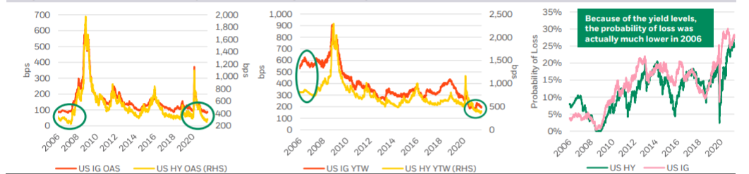
Fixed Income Review
September 2021
Fixed Income offers little “Income”
With that, a small move up in rates wipes out all of the carry for the year

Slide 156
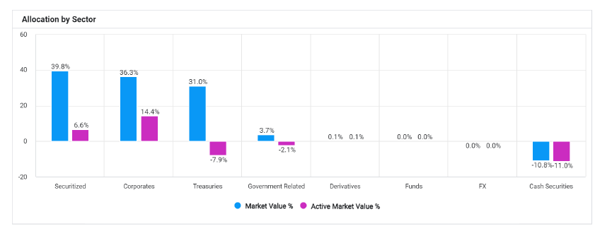
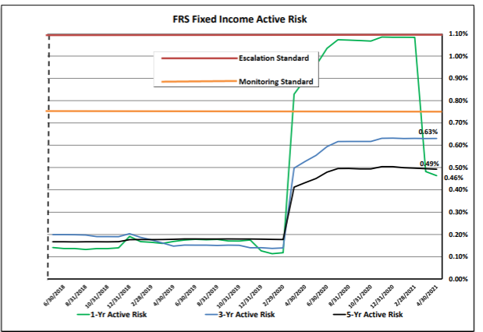
Fixed Income Review
September 2021
Portfolio continues to overweight Spread Product
But overall Active Risk continues contained at total allocation level

Slide 157
Fixed Income Review
September 2021
Looking Forward: Pockets of Value
Continue to maintain active allocation
Add exposure to out of benchmark structured products or other in a dedicated strategy
    Continuing to research opportunities outside of our benchmark, barbelling liquidity with yield
  Consider opportunity to reduce risk to a rising rate environment within overall allocation
    Increased allocation to Short Duration Credit manager
  Execute on tactical opportunities in out of Benchmark sectors – Core Plus opportunities
    Continuing to discuss opportunities ex-US, off benchmark, given limited opportunities in US Fixed Income. Considering derivative opportunities to increase ability to be nimble

Slide 158
Meeting of the Investment Advisory Council
Item 5. Real Estate Asset Class Update
Steve Spook, Senior Investment Officer
(See Attachments 5B)

Slide 159
State Board of Administration
Real Estate Update
Steve Spook
Senior Investment Officer
Investment Advisory Council Meeting
September 20, 2021

Slide 160
Real Estate Portfolio Sector Allocation as of 03/31/2021
Source: IBP 03/31/21 Report
Notes:
Private Market Core/NC in this presentation are SBA numbers.
Difference between Townsend and SBA
Townsend
Dexter NC
NHP NC
UTC C
Carlyle Crossing C
Skyhouse C
Market 1629 C
MWP Office Venture C
Hanover West SoMa C
Central Port Logistics C
Brittan West C
% FRS is from SBA Accounting’s IBP Report
TTG takes NAV and divides by total FRS.
TTG NAV does not match SBA NAV. SBA Accounting uses data through 10th working day of each month.
TTG uses actual quarter end data.

Slide 161
Private Market Leverage as of 03/31/2021
Private Portfolio
Market Value $21,098 M
Investment Portfolio Guidelines:
Private Market Portfolio leverage limited to 40% Loan to Value (LTV).
Principal Investments Portfolio leverage limited to 30% Loan to Value (LTV).
Notes:
Private Market Leverage is TTG. (SBA is 31.0%)
Discrepancy: TTG uses Fair Market Value of the debt. SBA uses Mortgage Payable.

Slide 162
Principal Investments Leverage
Investment Portfolio Guidelines
- Portfolio Leverage limited to 30% Loan To Value (LTV)
- Individual Asset Level limited to 50% LTV
- JV Individual Asset limited to 70% LTV
- Nonrecourse to the SBA

Slide 163
Total Real Estate Portfolio Performance
Data Through 03/31/2021
Source: The Townsend Group

Slide 164
Principal Investments Performance
Data Through 03/31/2021
Source: The Townsend Group

Slide 165
Externally Managed Portfolio Performance
Data Through 03/31/2021
Source: The Townsend Group

Slide 166
Private Market Property Type Diversification as of 03/31/2021
Target NFI-ODCE +/- 15%
Notes:
TTG

Slide 167
Private Market Geographic Diversification as of 03/31/2021
Target NFI-ODCE +/- 15%
Notes:
These are TTG numbers
Other = International plus some Ag properties:
Some Ag properties are included in Other in TTG numbers
Hancock reported 27.2% as Other
Prudential reported 12.3% as Other

Slide 168
Recent Activity
(Since Last IAC Report)
Principal Investments
  Acquisitions (Price/Equity)
  Industrial (2) $227 million/$159 million
  Manufactured Housing $187 million/$122 million
  Medical Office $11 million/$5 million
  Dispositions (Price/Equity)
  Industrial $7 million/$6 million
Externally Managed:
  New Commitments
  Closed-end US fund focused on Alternatives $75 million
  Closed-end US fund focused on Alternatives $100 million
  Closed-end Asia focused fund $100 million

Slide 169
Meeting of the Investment Advisory Council
Item 5. Strategic Investments Asset Class Update
Trent Webster, Senior Investment Officer
(See Attachments 5C)

Slide 170
State Board of Administration
Strategic Investments Asset Class Review
Trent Webster
Senior Investment Officer – Strategic Investments
Investment Advisory Council Meeting
September 20, 2021

Slide 171
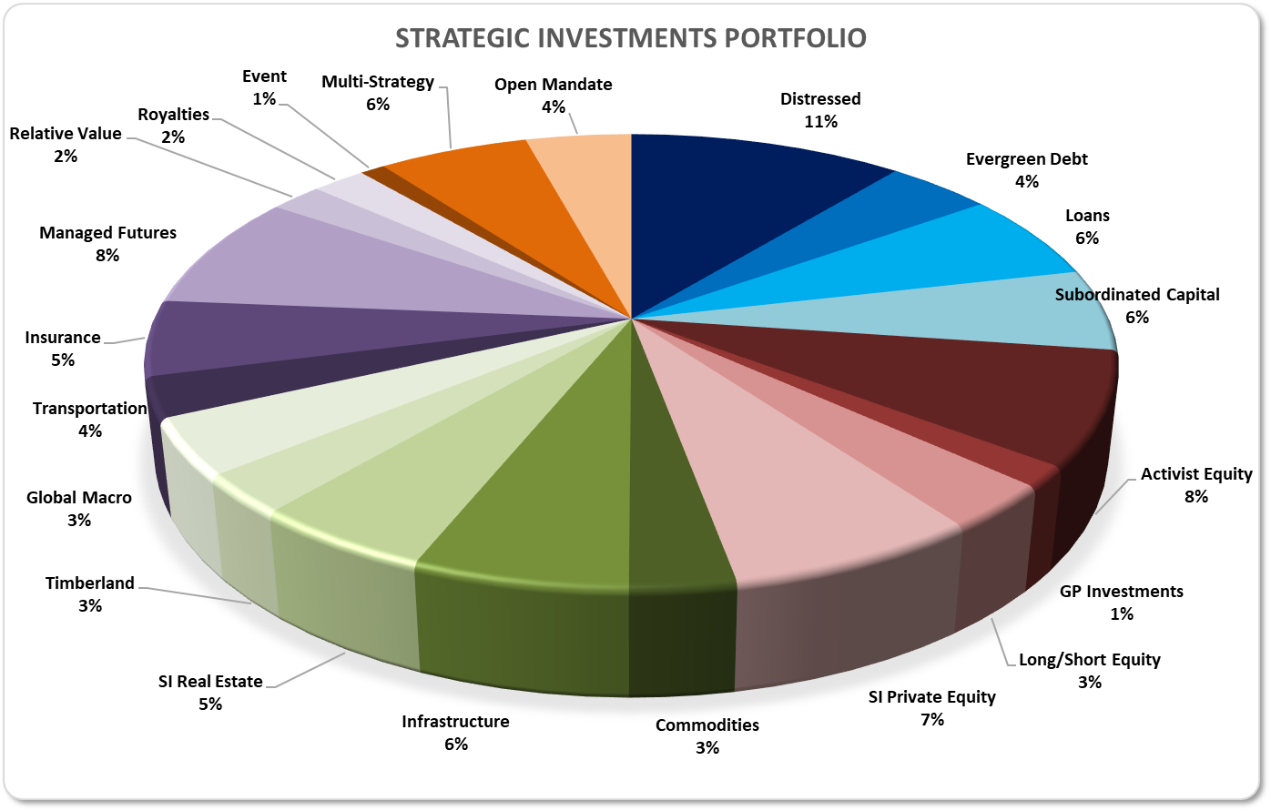
Portfolio

Slide 172
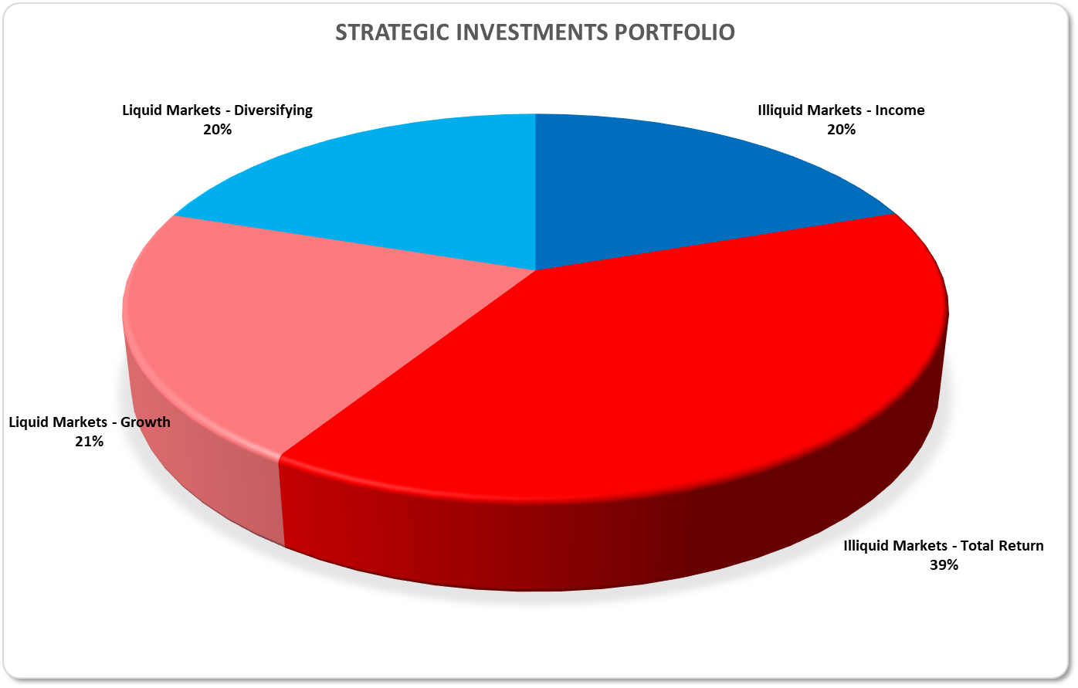
Portfolio

Slide 173
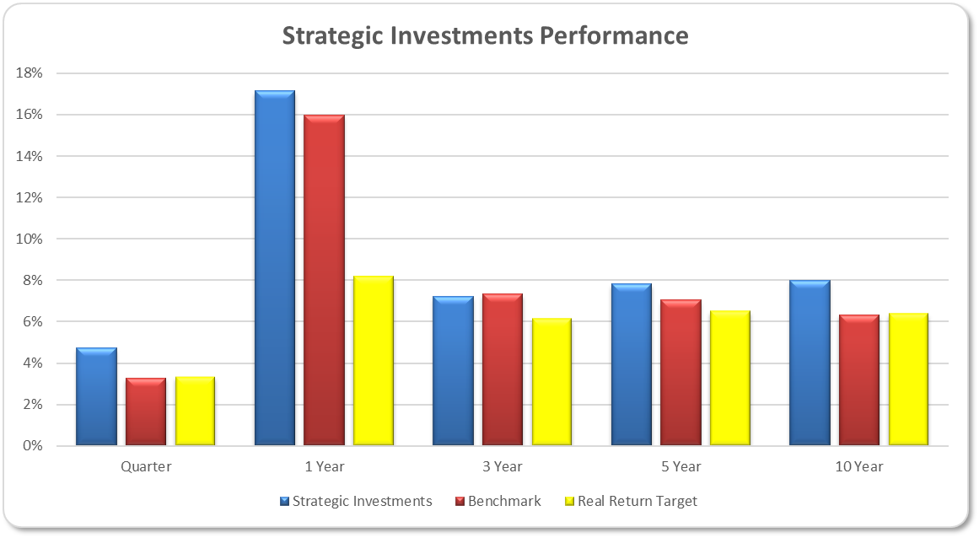
Performance

Slide 174
Recent Activity
Quarterly cash inflow of $94 million
Fiscal year cash outflow of $1.18 billion
Five funds totaling $950 million were closed in the most recent quarter
Zero funds have closed this quarter
Nine funds totaling $1.575 billion are in the pipeline

Slide 175
Pipeline
  Five Debt funds – Three Loan, one Distressed, one Subordinated Capital
  Three Real Asset funds – One Infrastructure, one Real Estate, one Transportation
  One Flexible Mandates fund – Open Mandate
  Three new relationships
  Nine private markets strategies
  No hedge funds

Slide 176
Investment Themes
Credit Markets
  Rapid recovery, but
  A lot of debt in the system
  Will the Fed come to the rescue if there is a blip in the markets?
  Insurance markets hardening
  Opportunities in aircraft as leisure travel set to accelerate
  Activists in Japan
  Commodities boom coming

Slide 177
Meeting of the Investment Advisory Council
Item 5. Private Equity Asset Class Update
John Bradley, Senior Investment Officer
(See Attachments 5D)

Slide 178
State Board of Administration
Private Equity Asset Class Update
John Bradley, SIO Private Equity
Investment Advisory Council
September 20, 2021

Slide 179
Market/Portfolio Update
Market/Portfolio Update:
  Market
    PE activity continues to surge following the COVID decline in 2020. Deal flow, volume, exits and fundraisings are all reaching post GFC highs.
    Venture-backed IPOs set a record in the 2nd quarter of 2021 with 44 IPOs raising $20.8 billion
  Portfolio
    PE portfolio up 13.3% in Q1 2021; up 65.7% for the 1 year-ended 3/31/21
    Venture capital portfolio continues its strong run, up 111.1% for the 1 year ended 3/31/21
    2021 net cash flow through 8/31/21: $1.2 billion (60% or $728 million from venture)

Slide 180
Sector and Geographic Exposure
As of March 31, 2021
Source: Cambridge Associates

Slide 181
Private Equity Asset Class Performance
Asset Class - Net Managed and Benchmark Returns (IRRs) as of March 31, 2021
Note: Asset class IRR performance data is provided by Cambridge Associates. The PE benchmark is currently the Custom Iran- and Sudan-free ACWI IMI + 300bps. From July 2010 through June 2014 the benchmark was the Russell 3000 + 300 bps. Prior to July 2010 , the benchmark was the Russell 3000 + 450 bps.

Slide 182
Sub-strategy Performance
As of March 31, 2021
 | 1yr | 3yr | 5yr | 10yr |  | Since Inception | Cambridge Median
U.S. Buyouts | 51.3% | 19.2% | 20.2% | 15.8% |  | 13.1% | 12.5%
Non-U.S. Buyouts | 56.7% | 20.7% | 20.0% | 16.4% |  | 13.7% | 14.7%
U.S. Venture | 111.1% | 41.4% | 27.4% | 21.7% |  | 17.6% | 16.2%
U.S. Growth Equity | 66.1% | 24.8% | 21.5% | 18.3% |  | 15.9% | 16.5%
Non-U.S. Growth Equity | 41.7% | 18.1% | 16.6% | 11.8% |  | 12.3% | 15.0%
Distressed/Turnaround | 49.0% | 15.0% | 15.9% | 13.6% |  | 19.6% | 9.7%
Secondaries | 36.4% | 12.9% | 14.2% | 12.5% |  | 15.7% | 17.7%
Total PE Asset Class | 65.7% | 24.2% | 21.4% | 16.7% |  | 14.6% | 13.2%
Sub-strategy returns and benchmark returns provided by Cambridge Associates and are calculated net of all fees and expenses. The Cambridge benchmark is the weighted average median return for the respective sub-strategy.

Slide 183
2021 Commitment Activity
Commitments totaling $1.2 billion to 12 funds through August 31, 2021
  $781 million to 6 buyout funds
    Small 26%, Middle-Market 42%, Large 32%
  $175 million to 3 venture funds
  $200 million to 2 distressed funds
  $40 million to one secondary fund
  Geographic Focus
    US 62%, Europe 0%, Asia 17%, Global 21%

Slide 184
Appendix

Slide 185
Private Equity Aggregates
Dollar-Weighted Performance (IRRs) as of March 31, 2021
 |  |  | Inception Date |  | Market Value (in Millions) |  | 1yr | 3yr | 5yr | 10yr | Since Inception
Total Private Equity |  |  | 1/27/1989 |  | $17,935.2 |  | 65.7% | 24.2% | 21.3% | 16.1% | 11.0%
 | Custom Iran- and Sudan-free ACWI IMI +300bps |  |  |  |  |  | 61.4% | 13.8% | 15.7% | 13.7% | 11.2%
Private Equity Legacy Portfolio |  |  | 1/27/1989 |  | $2.6 |  | 0.0% | -4.2% | -4.8% | -15.6% | 3.7%
 | Custom Iran- and Sudan-free ACWI IMI +300bps |  |  |  |  |  | 60.1% | 12.3% | 15.7% | 13.7% | 12.4%
Private Equity Asset Class Portfolio |  |  | 8/31/2000 |  | $17,932.6 |  | 65.7% | 24.2% | 21.4% | 16.7% | 14.6%
 | Custom Iran- and Sudan-free ACWI IMI +300bps |  |  |  |  |  | 61.4% | 13.8% | 15.7% | 13.7% | 12.4%
Note: Asset class IRR performance data is provided by Cambridge Associates. The PE benchmark is currently the Custom Iran- and Sudan-free ACWI IMI + 300bps. From July 2010 through June 2014 the benchmark was the Russell 3000 + 300 bps. Prior to July 2010 , the benchmark was the Russell 3000 + 450 bps. Prior to November 1999, Private Equity was part of the Domestic Equity asset class and its benchmark was the Domestic Equity target index + 750 bps.

Slide 186
Meeting of the Investment Advisory Council
Item 5. Florida Retirement System Investment Plan Update
Dan Beard, Chief Defined Contribution Programs
(See Attachments 5E)

Slide 187
FRS INVESTMENT PLAN

Slide 188
FRS Investment Plan Snapshot
(as of June 30, 2021)
Assets: $14.8 B (28.9% increase since June 30, 2020)
                5.77% - 2nd Quarter 2021 Return
                9.22% - Calendar Year 2021 to Date Return
                28.40% - Fiscal Year (July 20 – June 21)
Members: 261,385 (up 12.1% since June 30, 2020)
                Active – 180,836 (28% of active FRS membership)
                Inactive – 80,549
Average Acct Balance: $56,597 (8% increase since June 30, 2020)
Average Age: 46
                Males – 47 (35% of members)
                Females – 45 (65% of members)
Average Yrs of Service: 5 Years (active members)
Retirees: 162,529 (8% increase since June 30, 2020)
Distributions: $15.4 B
                Lump Sum Payouts – 40%
                Rollovers – 60%

Slide 189
FRS Investment Plan Performance by Asset Class
(as of June 30, 2021)

Slide 190
FRS Investment Plan AUM by Asset Class
(as of June 30, 2021 in $ millions)

Slide 191
FRS Investment Plan Membership Growth
Percent Membership Growth Year to Year

Slide 192
MyFRS Financial Guidance Program
(as of June 30, 2021)
(% change from previous 12 months)
22 Annuities purchased last 12 months ($2.09 million)
171 Total Annuities purchased inception to date ($21.8 million)

Slide 193
Questions?

Slide 194
Meeting of the Investment Advisory Council
Item 5. Investment Programs & Governance Update
Mike McCauley, Senior Officer Investment Programs & Governance
(See Attachments 5F)

Slide 195
Investment Programs & Governance (IP&G)
Michael McCauley
Senior Officer
Investment Advisory Council Meeting – September 20, 2021

Slide 196
Corporate Governance/Proxy Voting Summary
FY21 voting levels show slight decline in total number of meetings and vote count
  SEC approved NASDAQ Board Diversity Requirements
  Japanese Stock Listing Reforms

Slide 197
2021 Proxy Season
The COVID-19 pandemic affected shareowner-voting activity for a second year in a row, with sustained use of virtual shareowner meetings by many companies.
Governance resolutions declined marginally somewhat year-over-year and receive mixed average support levels depending on the type of proposal.
New resolutions introduced on employee representation on boards and requests for companies to convert to a public benefit corporation or “PBC.”
There were a record number of environmental and social (E&S) resolutions submitted, which represented the majority of all U.S. shareowner proposals. A record number of E&S proposals received majority support from the largest asset owners and managers.

Slide 198
Appendix
SBA Corporate Governance Statistics

Slide 199
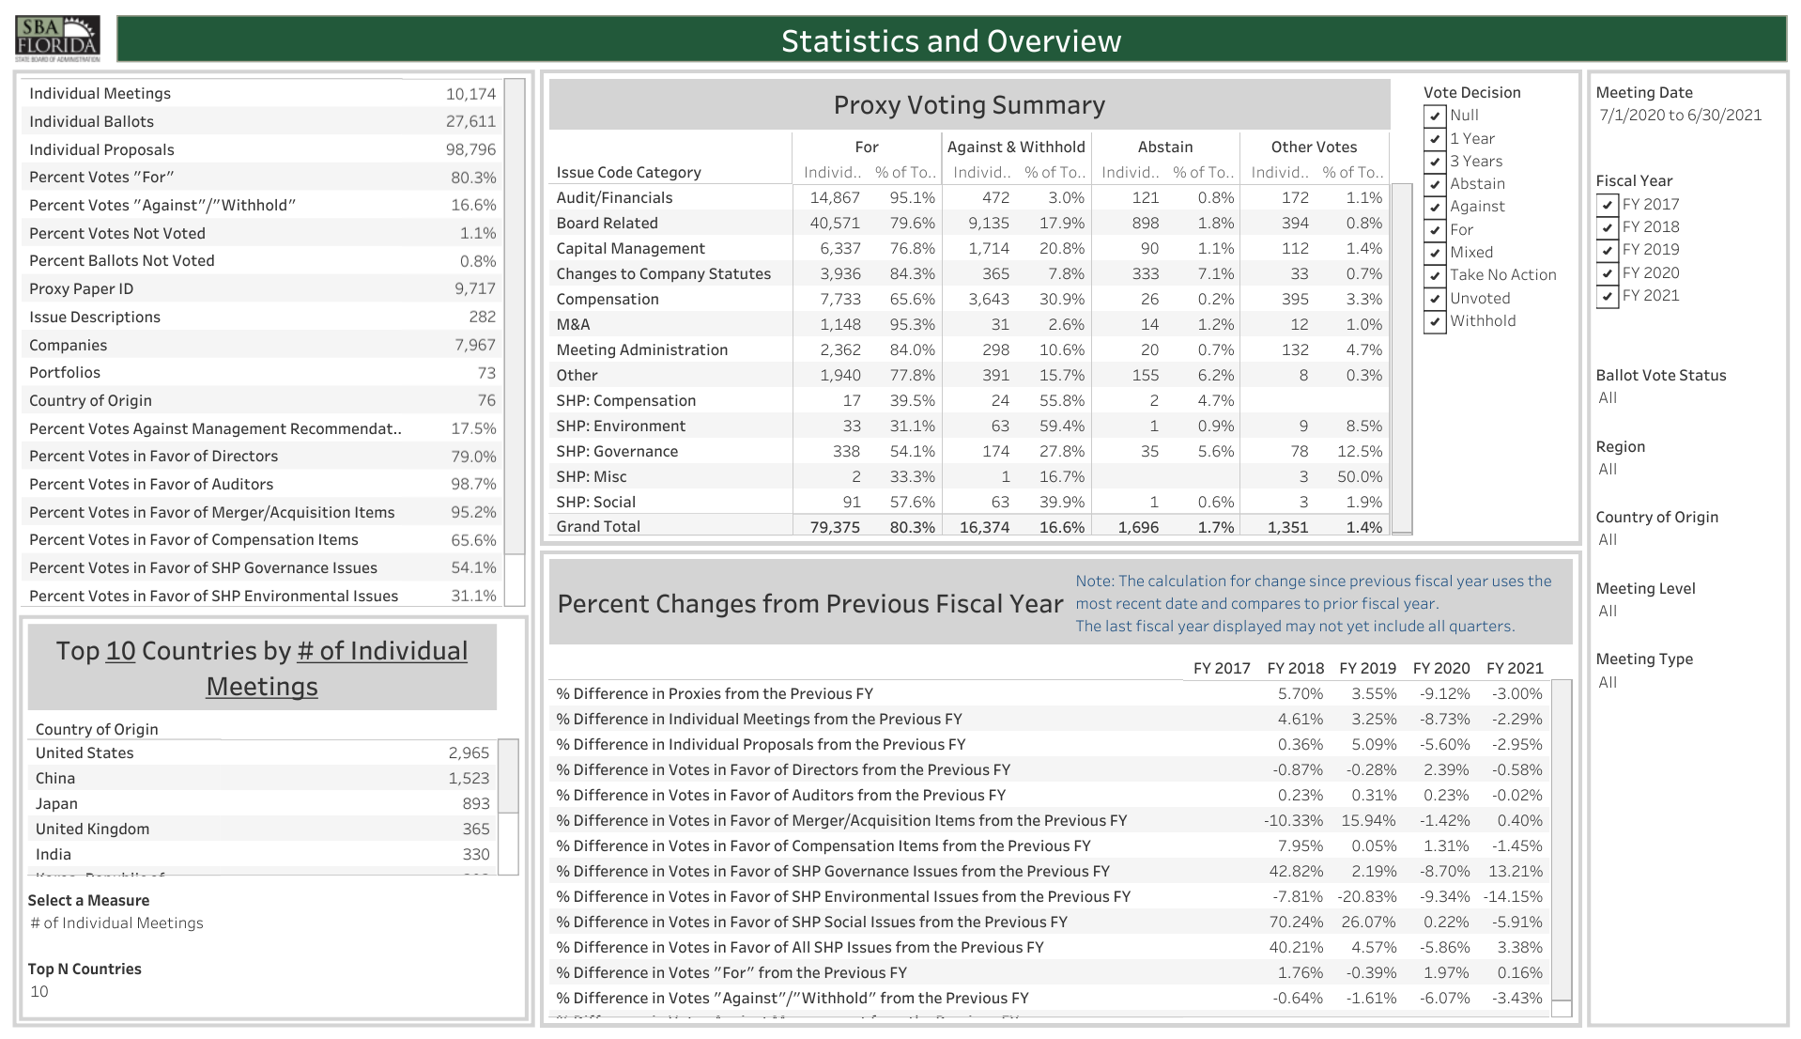

Slide 200
Meeting of the Investment Advisory Council
Item 6. Major Mandate Review
Kristen Doyle, Aon
Katie Comstock, Aon
(See Attachment 6A)

Slide 201

State Board of Administration of Florida
Major Mandate Review
Second Quarter 2021

Slide 202
Table of Contents
Executive Summary
Pension Plan Review
Investment Plan Review
CAT Fund Review
Lawton Chiles Endowment Fund Review
Florida PRIME Review
Appendix

Slide 203
Executive Summary
  The major mandates each produced generally strong returns relative to their respective benchmarks over both short- and long-term time periods ending June 30, 2021.
  The Pension Plan outperformed its Performance Benchmark over the trailing quarter, one-, three-, five-, ten-, and fifteen-year periods.
    Over the trailing five-year period, Global Equity is the leading source of value added, followed by Private Equity.
    Over the trailing one, three, five and ten-year periods, the Pension Plan’s return ranked above the median plan in the TUCS Top Ten Defined Benefit Plan universe.
  The FRS Investment Plan outperformed the Total Plan Aggregate Benchmark over the trailing quarter, one-, three-, five-, and ten-year periods.
  The Lawton Chiles Endowment Fund outperformed its benchmark over the trailing quarter, one-, three- five- and ten-year periods.
  The CAT Funds’ performance is strong over long-term periods, outperforming the benchmark over the trailing five- and ten-year periods.
  Florida PRIME has continued to outperform its benchmark over both short- and long-term time periods.

Slide 204
Pension Plan: Executive Summary
  The Pension Plan assets totaled $199.6 billion as of June 30, 2021, which represents a $11.0 billion increase since last quarter.
  The Pension Plan, when measured against the Performance Benchmark, outperformed over the trailing quarter, one-, three-, five-, ten-, and fifteen- year periods.
  Relative to the Absolute Nominal Target Rate of Return, the Pension Plan outperformed over all trailing time periods shown.
  The Pension Plan is well-diversified across six broad asset classes, and each asset class is also well-diversified.
    Public market asset class investments do not significantly deviate from their broad market-based benchmarks, e.g., sectors, market capitalizations, global regions, credit quality, duration, and security types.
    Private market asset classes are well-diversified by vintage year, geography, property type, sectors, investment vehicle/asset type, and investment strategy.
    Asset allocation is monitored on a daily basis to ensure that the actual asset allocation of the Pension Plan remains close to the long-term policy targets set forth in the Investment Policy Statement.
  Aon Investment Consulting and SBA staff revisit the plan design annually through informal and formal asset allocation and asset liability reviews.
  Adequate liquidity exists within the asset allocation to pay the monthly obligations of the Pension Plan consistently and on a timely basis.

Slide 205
FRS Pension Plan Change in Market Value
Periods Ending 6/30/2021
Summary of Cash Flows
Second Quarter
Fiscal YTD*
Beginning Market Value
$188,580,636,479
$160,714,203,703
+/- Net Contributions/(Withdrawals)
$(1,828,420,748)
$(7,536,029,498)
Investment Earnings
$12,848,282,655
$46,422,324,180
= Ending Market Value
$199,600,498,385
$199,600,498,385
Net Change
$11,019,861,906
$38,886,294,682
*Period July 2020 – June 2021

Slide 206
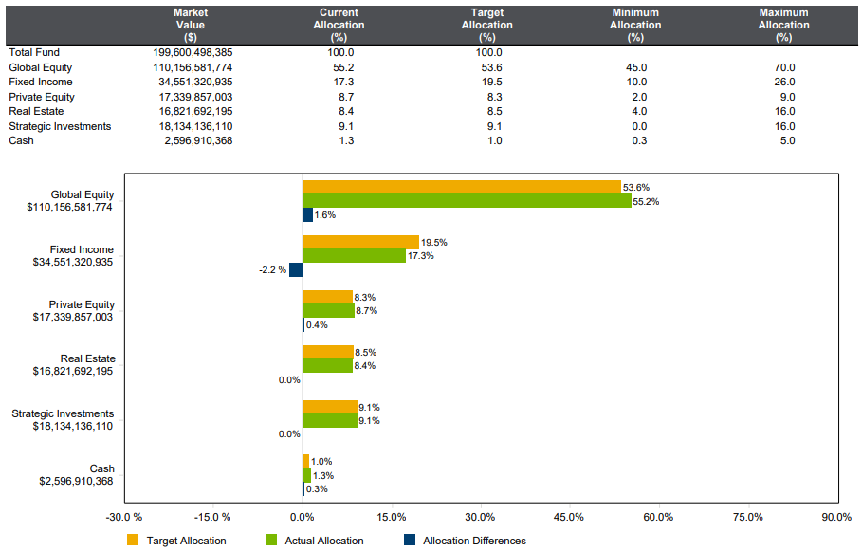
Asset Allocation as of 6/30/2021
Total Fund Assets = $199.6 Billion

Slide 207
FRS Pension Plan Investment Results
Periods Ending 6/30/2021
Total FRS Pension Plan
Performance Benchmark
Absolute Nominal Target Rate of Return

Slide 208
FRS Pension Plan Investment Results
Periods Ending 6/30/2021
Long-Term FRS Pension Plan Performance Results
vs. SBA's Long-Term Investment Objective
Total FRS Pension Plan
Absolute Nominal Target Rate of Return

Slide 209
Comparison of Asset Allocation (TUCS Top Ten)
As of 3/31/2021
FRS Pension Plan vs. Top Ten Defined Benefit Plans
FRS TOTAL FUND
TUCS TOP TEN
*Global Equity Allocation: 27.5% Domestic Equities; 21.3% Foreign Equities; 6.1% Global Equities; 1.0% Global Equity Liquidity Account. Percentages are of the Total FRS Fund.
**Global Equity Allocation: 31.3% Domestic Equities; 21.1% Foreign Equities.
Note: The TUCS Top Ten Universe includes $1,915.5 billion in total assets. The median fund size was $180.5 billion
and the average fund size was $191.6 billion.
Note: Due to rounding, percentage totals displayed may not sum perfectly.

Slide 210
FRS Results Relative to TUCS Top Ten Defined Benefit Plans
Periods Ending 6/30/2021
Total FRS (Gross)
Top Ten Median Defined Benefit Plan Fund (Gross)
Note: The TUCS Top Ten Universe includes $2,018.9 billion in total assets. The median fund size was $193.1 billion
and the average fund size was $201.9 billion.

Slide 211
Top Ten Defined Benefit Plans FRS Universe Comparison (TUCS)
Periods Ending 6/30/2021
Total FRS
Top Ten Median Defined Benefit Plan Universe
FRS Percentile Ranking
1 25 5 37
Note: The TUCS Top Ten Universe includes $2,018.9 billion in total assets. The median fund size was $193.1 billion
and the average fund size was $201.9 billion.

Slide 212
Investment Plan: Executive Summary
  The FRS Investment Plan outperformed the Total Plan Aggregate Benchmark over the trailing quarter, one-, three-, five-, and ten-year periods. This suggests strong relative performance of the underlying fund options in which participants are investing.
  The FRS Investment Plan’s total expense ratio is slightly higher, on average, when compared to a defined contribution peer group and is lower than the average corporate and public defined benefit plan, based on year-end 2020 data. The total FRS Investment Plan expense ratio includes investment management fees, as well as administration, communication and education costs. Communication and education costs are not charged to FRS Investment Plan members; however, these and similar costs may be charged to members of plans within the peer group.
  Management fees are lower than the median as represented by Morningstar’s mutual fund universe for every investment category.
  The FRS Investment Plan offers an appropriate number of fund options that span the risk and return spectrum.
  The Investment Policy Statement is revisited periodically to ensure that the structure and guidelines of the FRS Investment Plan are appropriate, taking into consideration the FRS Investment Plan’s goals and objectives.

Slide 213
Total Investment Plan Returns & Cost
Periods Ending 6/30/2021*
 | One-Year | Three-Year | Five-Year | Ten-Year
FRS Investment Plan | 28.4% | 11.5% | 11.5% | 8.5%
Total Plan Aggregate Benchmark** | 27.3% | 11.0% | 10.9% | 8.1%
FRS Investment Plan vs. Total Plan Aggregate Benchmark | 1.1 | 0.5 | 0.6 | 0.4
Periods Ending 12/31/2019***
 | Five-Year Average Return**** | Five-Year Net Value Added | Expense Ratio
FRS Investment Plan | 7.1% | 0.2% | 0.32%*****
Peer Group | 7.2 | 0.1 | 0.26
FRS Investment Plan vs. Peer Group | -0.1 | 0.1 | 0.06
*Returns shown are net of fees.
**Aggregate benchmark returns are an average of the individual portfolio benchmark returns at their actual weights.
***Source: 2020 CEM Benchmarking Report. Peer group for the Five-Year Average Return and Value Added represents the U.S. Median plan return based on the CEM 2020 Survey that included 119 U.S. defined contribution plans with assets ranging from $112 million to $67.2 billion. Peer group for the Expense Ratio represents a custom peer group for FSBA of 17 DC plans including corporate and public plans with assets between $3.1 - $25.3 billion.
****Returns shown are gross of fees.
*****The total FRS Investment Plan expense ratio includes investment management fees, as well as administration, communication and education costs. These latter costs are not charged to FRS Investment Plan members; however, these and similar costs may be charged to members of plans within the peer group utilized above.

Slide 214
CAT Fund: Executive Summary
  Returns on an absolute basis continue to be modest given the current low interest rate environment.
  All CAT Funds are adequately diversified across issuers within the short-term bond market.
  The Investment Portfolio Guidelines appropriately constrain the CAT Funds to invest in short-term and high-quality bonds to minimize both interest rate and credit risk.
  Adequate liquidity exists to address the cash flow obligations of the CAT Funds.
  The Investment Portfolio Guidelines are revisited periodically to ensure that the structure and guidelines of the CAT Funds are appropriate, taking into consideration the CAT Funds’ goals and objectives.
  Over long-term periods, the relative performance of the CAT Operating Funds has been favorable as they have outperformed the Performance Benchmark over the trailing five- and ten-year time periods.

Slide 215
CAT Operating Funds Investment Results
Periods Ending 6/30/2021
*CAT Operating Funds: Beginning March 2008, the returns for the CAT Operating Funds reflect marked-to-market returns. Prior to that time, cost-based returns are used. Beginning February 2018, the CAT Operating Funds were split into two different sub funds, the CAT Fund Operating Liquidity Fund and the CAT Fund Operating Claims Paying Fund. Performance for each sub fund is shown below.
**Performance Benchmark: Effective January 1, 2021, the CAT Fund Operating Liquidity Fund is benchmarked to the Bloomberg U.S. Treasury Bills 3-6 Months & U.S. Treasury Bills 6-9 Months Custom Blend Index. This benchmark is comprised of 60% of 3-6 month U.S. Treasury Bills and 40% 6-9 month U.S. Treasury Bills Beginning February 2018, the CAT Fund Operating Liquidity Fund was benchmarked to the B of A Merrill Lynch 3-6 Month U.S. Treasury Bill Index. Effective January 1, 2021, the CAT Operating Claims Paying Fund is benchmarked to the Bloomberg U.S. Treasury 1-3 Years & Corporate AA+ ex 144A with Reg S Custom Blend Index. This benchmark is comprised of 65% 1-3 year U.S. Treasury and 35% of 1-3 year Corporate AA or better excluding 144A and Reg S securities. Beginning February 2018, the CAT Fund Operating Claims Paying Fund benchmark is a blend of 35% of the Bank of America Merrill Lynch 1-3 Year AA U.S. Corporate Bond Index and 65% of Bank of America Merrill Lynch 1-3 Year U.S. Treasury Index. Additional benchmark history can be found in the appendix.

Slide 216
Lawton Chiles Endowment Fund: Executive Summary
  Established in July 1999, the Lawton Chiles Endowment Fund (LCEF) was created to provide a source of funding for child health and welfare programs, elder programs and research related to tobacco use.
    The investment objective is to preserve the real value of the net contributed principal and provide annual cash flows for appropriation.
    The Endowment’s investments are diversified across various asset classes including global equity, fixed income, inflation-indexed bonds (TIPS) and cash.
  The Endowment assets totaled $1.1 billion as of June 30, 2021.
  The Endowment’s return outperformed its Target over the trailing quarter, one-, three-, five-, and ten-year time periods.

Slide 217
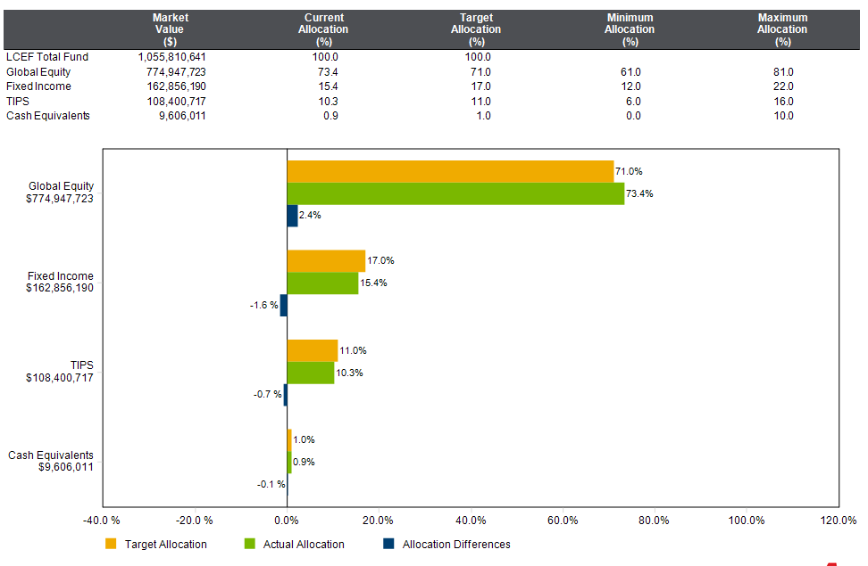
Asset Allocation as of 6/30/2021
Total LCEF Assets = $1.1 Billion

Slide 218
LCEF Investment Results
Periods Ending 6/30/2021
Total LCEF
Performance Benchmark

Slide 219
Florida PRIME: Executive Summary
  The purpose of Florida PRIME is safety, liquidity, and competitive returns with minimal risk for participants.
  The Investment Policy Statement appropriately constrains Florida PRIME to invest in short-term and high quality bonds to minimize both interest rate and credit risk.
  Florida PRIME is adequately diversified across issuers within the short-term bond market, and adequate liquidity exists to address the cash flow obligations of Florida PRIME.
  Performance of Florida PRIME has been strong over short- and long-term time periods, outperforming its performance benchmark during the quarter and over the trailing one-, three-, five-, and ten-year time periods.
  As of June 30, 2021, the total market value of Florida PRIME was $17.4 billion.
  Aon Investments USA Inc., in conjunction with SBA staff, compiles an annual best practices report that includes a full review of the Investment Policy Statement, operational items, and investment structure for Florida PRIME.

Slide 220
Florida PRIME Investment Results
Periods Ending 6/30/2021
FL PRIME Yield 30-Day Average
S&P AAA & AA GIP All 30-Day Net Yield Index**
*Returns less than one year are not annualized.
**S&P AAA & AA GIP All 30-Day Net Yield Index for all time periods shown.

Slide 221
Florida PRIME Risk vs. Return
1 Years Ending 6/30/2021
Florida PRIME
1 M LIBOR
90-Day T-Bill
S&P US AAA & AA Rated GIP All 30-Day Net

Slide 222
Florida PRIME Risk vs. Return
3 Years Ending 6/30/2021
90-Day T-Bill
Florida PRIME
1 M LIBOR
S&P US AAA & AA Rated GIP All 30-Day Net

Slide 223
Florida PRIME Risk vs. Return
5 Years Ending 6/30/2021
Florida PRIME
1 M LIBOR
S&P US AAA & AA Rated GIP All 30-Day Net
90-Day T-Bill

Slide 224
Return Distribution
Periods Ending 6/30/2021

Slide 225
Standard Deviation Distribution
Periods Ending 6/30/2021

Slide 226
Appendix

Slide 227
FRS Investment Plan Costs
Investment Category | Investment Plan Fee* | Average Mutual Fund Fee**
Domestic Equity | 0.16% | 0.87%
International Equity | 0.32% | 0.95%
Diversified Bonds | 0.14% | 0.45%
Target Date | 0.14% | 0.45%
Money Market | 0.06% | 0.24%
Inflation Protected Securities | 0.36% | 0.35%
*Average fee of multiple products in category as of 6/30/2021.
**Source: Aon’s annual mutual fund expense analysis as of 12/31/2020.

Slide 228
Investment Plan Fiscal Year End Assets Under Management
By Fiscal Year ($ millions)
Source: Investment Plan Administrator

Slide 229
Investment Plan Membership
* Period Ending 6/30/2021
Source: Investment Plan Administrator

Slide 230
Florida Hurricane Catastrophe Funds Background and Details
  The purpose of the Florida Hurricane Catastrophe Fund (FHCF) is to provide a stable, ongoing and timely source of reimbursement to insurers for a portion of their hurricane losses.
  The CAT Operating Funds, along with CAT 2016 A Fund and CAT 2020 A Fund are internally managed portfolios.
    CAT 2013 A Fund was liquidated during 4Q 2020
  As of June 30, 2021, the total value of:
      The CAT Operating Funds was $12.5 billion
      The CAT 2016 A Fund was $0.04 billion
      The CAT 2020 A Fund was $3.5 billion
  History of the CAT Funds Benchmarks: The CAT Operating Funds were benchmarked to the IBC First Tier through February 2008. From March 2008 to December 2009, it was the Merrill Lynch 1-Month LIBOR. From January 2010 to June 2010, it was a blend of the average of the 3-Month Treasury Bill rate and the iMoneyNet First Tier Institutional Money Market Funds Gross Index. From July 2010 to September 2014, it was a blend of the average of the 3-Month Treasury Bill rate and the iMoneyNet First Tier Institutional Money Market Funds Net Index. Effective October 2014, it is a blend of the average of the Merrill Lynch 1-Yr U.S. Treasury Bill Index and the iMoneyNet First Tier Institutional Money Market Funds Net Index. Beginning February 2018, the CAT Operating Funds were split into two different sub funds, the CAT Fund Operating Liquidity Fund and the CAT Fund Operating Claims Paying Fund. Beginning February 2018, the CAT Fund Operating Liquidity Fund was benchmarked to the B of A Merrill Lynch 3-6 Month U.S. Treasury Bill Index, and the CAT Fund Operating Claims Paying Fund benchmark is a blend of 35% of the Bank of America Merrill Lynch 1-3 Year AA U.S. Corporate Bond Index and 65% of Bank of America Merrill Lynch 1-3 Year U.S. Treasury Index.

Slide 231
CAT 2020 A and 2016 A Funds Investment Results
Periods Ending 6/30/2021
*Performance Benchmark: Blend of 35% of the ICE 1-3 Year AA U.S. Corporate Bond Index and 65% of ICE 1-3 Year U.S. Treasury Index excluding 144A securities through December 31, 2020
**Performance Benchmark: Beginning February 2018, the CAT 2016 A Funds was benchmarked to itself.

Slide 232
CAT Operating Funds Characteristics
Period Ending 6/30/2021

Slide 233
CAT 2020 A Fund Characteristics
Period Ending 6/30/2021

Slide 234
CAT 2016 A Fund Characteristics
Period Ending 6/30/2021

Slide 235
Florida PRIME Characteristics
Quarter Ending 6/30/2021
*Period July 2020 – June 2021

Slide 236
Florida PRIME Characteristics
Quarter Ending 6/30/2021
Portfolio Composition

Slide 237
Florida PRIME Characteristics
Period Ending 6/30/2021

Slide 238
Meeting of the Investment Advisory Council
Item 7. IAC Compensation Subcommittee Update
(See Attachment 7)
Peter Jones, Chair

Slide 239
Meeting of the Investment Advisory Council
Item 8. Audience Comments/2022 Meeting Dates/Closing Remarks/Adjourn
(See Attachments 8A-8B)
Peter Jones, Chair

